Slide 1



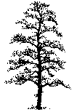
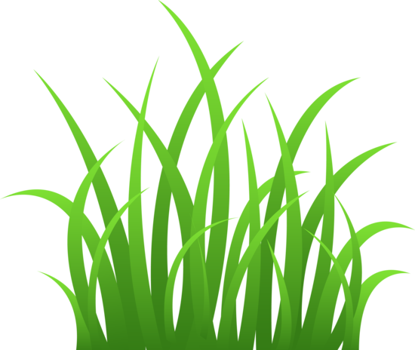
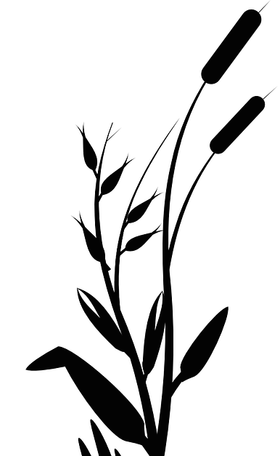
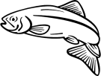
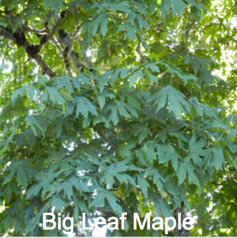
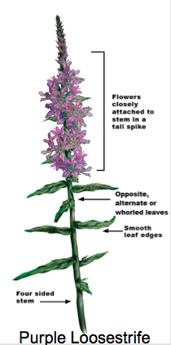
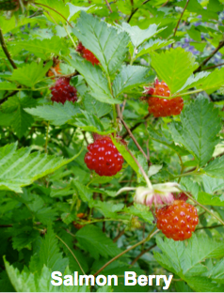
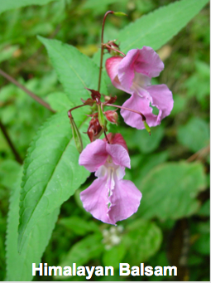
Healthy Riparian Ecosystem
Disturbed Riparian Ecosystem
Increased heat stress due to lack of shade resulting in greater evaporation
Vegetation provides shade to salmon and other animals
Loss of diverse habitat type
Banks stabilized from plant roots
Vegetation slows down the speed of the water during periods of high water flow
Actively eroding banks
Upland
Riparian Transition Zone
Lower average water level
Riparian Transition Zone
Upland
Coniferous trees: Douglas Fir, Western Red Cedar²
Broad Leaf trees: Cottonwood, Alder, Maple, and grasses²
Higher water storage
Effects of Disturbance³ Low amounts of vegetation to stabilize banks and provide shade. Little or no summer stream flow due to reduced soil saturation and storage capacity. Poor habitat for fish, and other aquatic life forms. Low forage plant productivity resulting in less food for animals and cattle⁸. Greater magnitude of flooding than normal levels. Lack of vegetation that normally provides resistance against the water, slowing it down. Increased sediment from erosion in the lowest areas of the stream bed can cause decreases of 10-20% in the amount of chum salmon eggs⁹.
What is a Riparian Zone? Riparian zones are areas of vegetation between freshwater ecosystems (streams, rivers, lakes) and land that serve a large ecological roll. Riparian habitats offer diverse habitat types for different plants and animals., serve as pathways for migrating organisms⁵ Riparian ecosystems are often threatened because they are located in depressions and valleys which is where run off water and pollutants flow to, and where humans typically settle. Riparian zones can naturally occur or can be constructed by humans if necessary. Riparian areas often support the highest species richness when compared with other nearby areas⁸. The trees and vegetation in a riparian area offer a great deal of shade to the area and to this benefits organisms in and around the water. The shade provided in riparian areas keeps temperatures around 1º to 3º Celsius warmer than areas without shade.
Lower water storage
Increased sediment in stream bed
Stream Bed
Benefits of a Healthy Riparian Zone Plant roots assist in supporting the stream bank and preventing erosion.¹ High diversity of different types of wildlife habitat.¹ As water drains into a stream, vegetation assists in filtering sediment and minerals which are then absorbed into the soil.¹ 60% of British Columbia’s threatened species live in riparian zones.¹ Salmon will use this ecosystem as a spawning area for their eggs² Leaf litter and logs in the riparian area provide habitat for small insects to live
Potential Future Impacts The impacts caused by changing climate can severely impact riparian zones. Annual average temperatures have increased ~0.56-1.1°C from coastal British Columbia to northwestern California over the 20th century⁵. As riparian zones are somewhat small and have a large diversity in inhabitants, these systems are particularly sensitive to disturbance and changes⁷. The best way to minimize the impacts to these changes is to maintain healthy riparian sites in their current locations. For locations that have been degraded by human activities or are lacking in riparian biodiversity, Management efforts are beneficial. If vegetation is replanted in these areas it can assist with lowering the speed of the water, stabilizing the banks, and providing a lower temperature of water for life forms. Because we rely on riparian zones for fresh water, food, and protection from flooding, it is important that we facilitate healthy systems in Squamish. Some of the impacts that may be felt in Squamish are increased winter precipitation resulting in higher winter/spring river flows and lower summer flows which causes a drop in soil moisture, and increased water temperature due to increased sun exposure, which is harmful to fish species. These impacts can hurt the entire food web and cause changes within the ecosystem as a whole.
Invasive Plant Species Threatening Squamish Riparian Habitats⁴ Himalayan balsam clogs drainages and causes erosion. Butterfly bushes choke out native plants and may alter soil nutrient levels. Purple loosestrife grows in marshes and riparian areas, and in a single growing season can cover an entire marsh, restricting water flow. Yellow iris creates dense thickets that can block waterways and limit native plants. Yellow iris is also toxic if ingested by livestock or humans.
References:
Scott, L., & Delesalle, B. (2003, January 1). The Value of Riparian Habitat and How to Care For. (n.a.)
E-Flora BC: Electronic Atlas of the Flora of British Columbia. Lab for Advanced Spatial Analysis, Department of Geography, University of British Columbia, Vancouver.
Elmore, W., & Beschta, R. L. (1987). Riparian areas: perceptions in management. Rangelands Archives, 9(6), 260-265
Sea to Sky Invasive Species Council. (March 2012). Sea to Sky Corridor Invasive Plants: A Guide to Identification & Management, 1-45
Nilsson, C., & Berggren, K. (2000). Alterations of Riparian Ecosystems Caused by River Regulation Dam operations have caused global-scale ecological changes in riparian ecosystems.. BioScience, 50(9), 783-792.
Bowler, D. E., Mant, R., Orr, H., Hannah, D. M., & Pullin, A. S. (2012). What are the effects of wooded riparian zones on stream temperature. Environmental Evidence, 1(3).
Meyer, J. L., Sale, M. J., Mulholland, P. J., & Poff, N. L. (1999). Impacts of Climate Change on Aquatic Ecosystem Functioning and Health
Gregory, S.V., G.A. Lamberti, D.C. Erman, K.V. Koski, M.L. Murphy, and J.R. Sedell. 1987. Influence of forest practices on aquatic production.
Holtby, L.B. and J.C. Scrivener. (1989_. Observed and simulated effects of climatic variability, clearcut logging, and fishing on the numbers of chum salmon (Oncorhynchus keta) and coho salmon (O. kisutch) returning to Carnation Creek, British Columbia
Images:
http://upload.wikimedia.org/wikipedia/commons/5/57/Impatiens_Glandulifera.jpg
http://www.purpleloosestrife.uconn.edu/DrawingsDiagrams/loosestrife%20-%20labeled.jpg
http://msucares.com/news/print/sgnews/sg13/images/sg20130225_buzz300.jpg
https://northwesttribes.files.wordpress.com/2010/04/salmonberries-on-plant.jpg
http://cdn.c.photoshelter.com/img-get2/I00007loS4MgdbBs/fit=1000x750/red-alder-forest-duckabush-EdBook618.jpg
http://horticulture.oregonstate.edu/system/files/media_images/July%202011%20274.JPG
Created by Kavanagh McGeough

