Slide 1


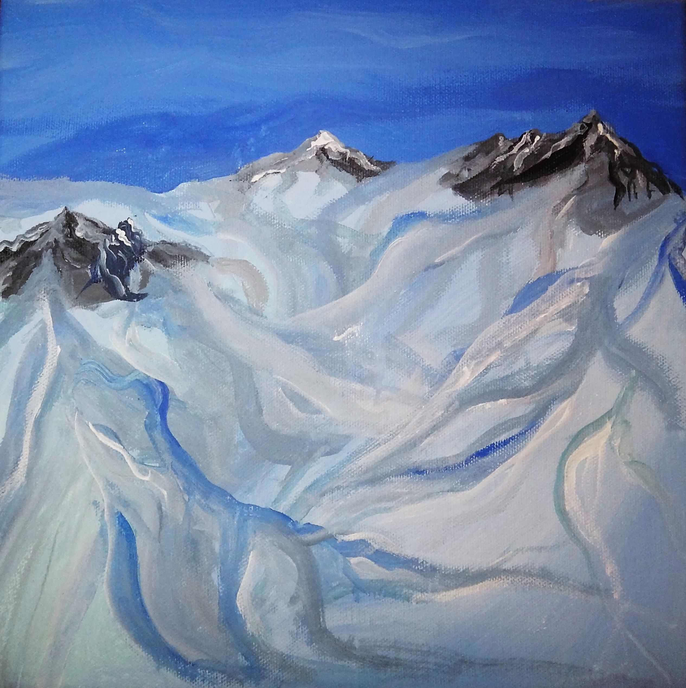
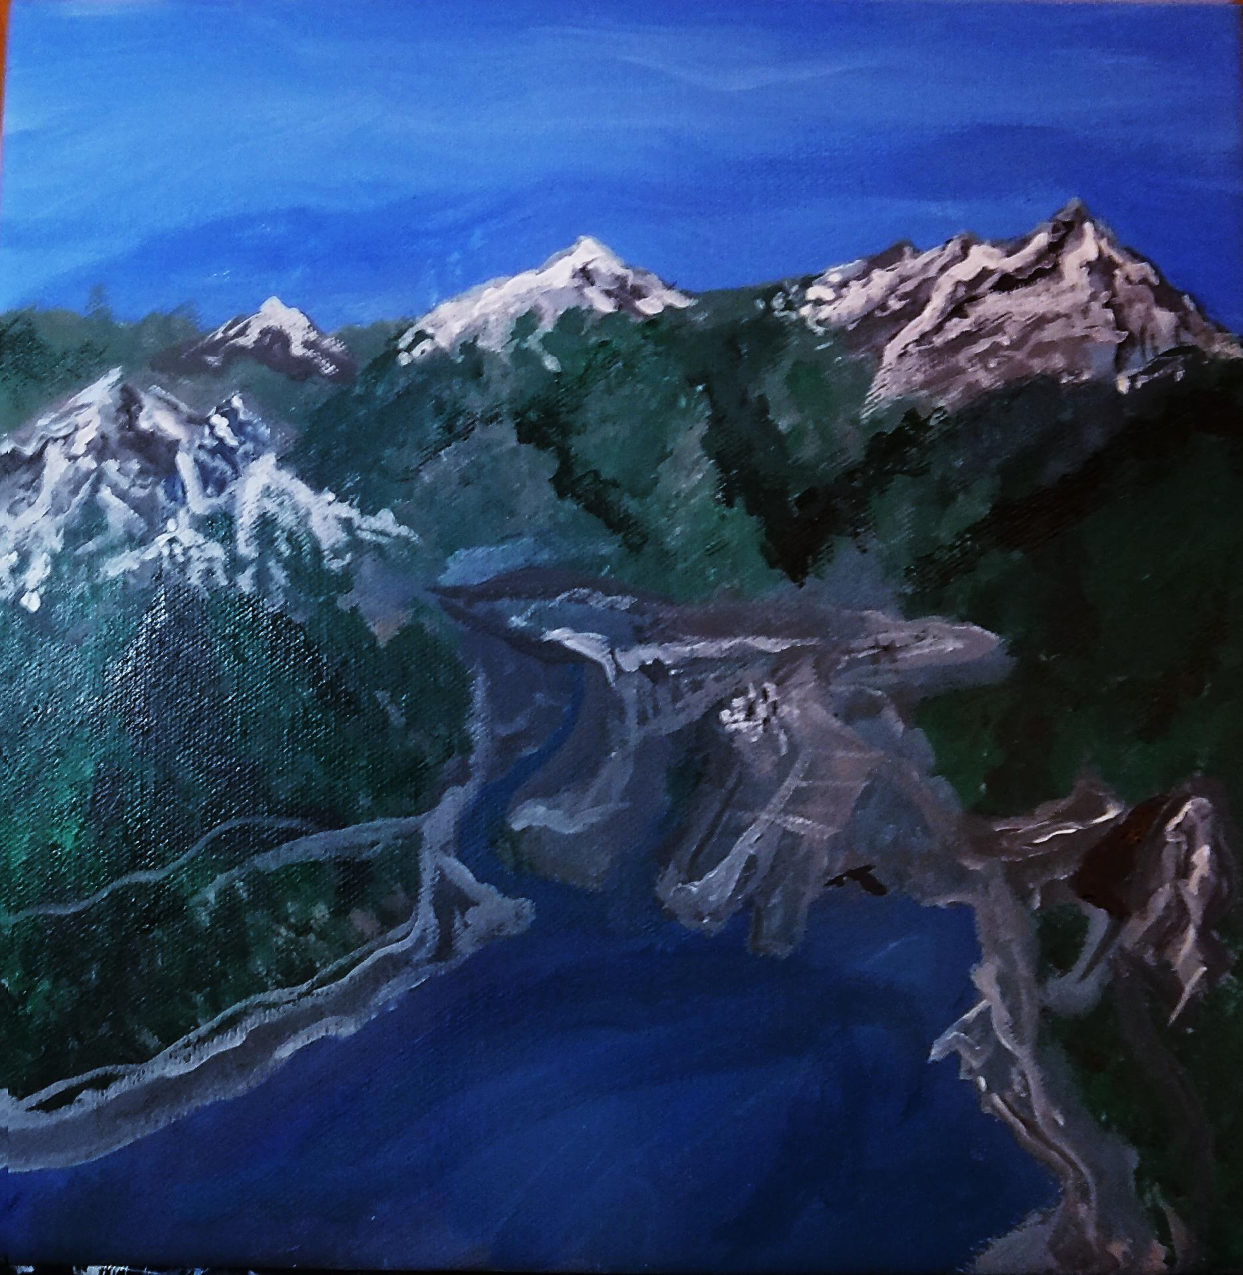
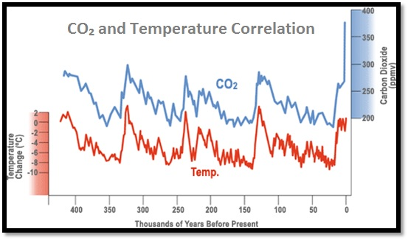
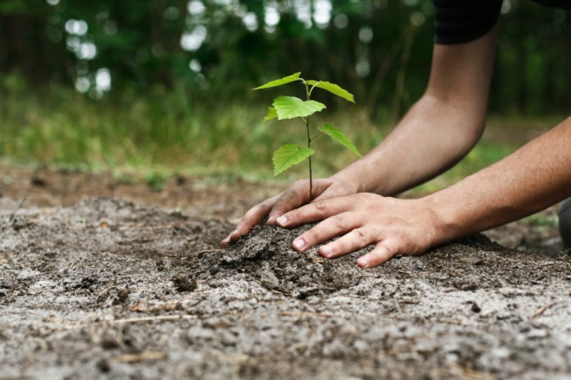
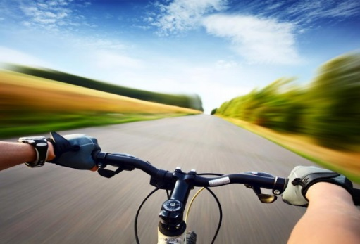
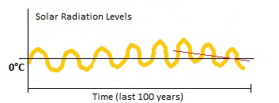
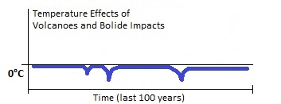
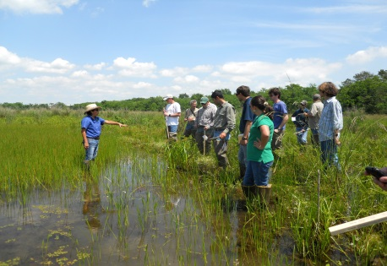

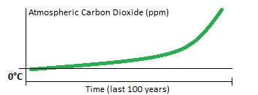

Squamish…Then and Now
How do we know what climate was like in the past?
Paleothermometers are different methods we can use to understand climate throughout earth’s history. One way to determine the past climate of an area is by using geomorphology, the study of land formations. Small-scale aspects on the land surface can also give us a clue about past climate like striation marks (linear markings from rock being scraped against a glacier) and white colouring on rock faces (indicating limestone and the presence of a past lake). Isotope-based paleothermometers including ice-cores, ocean sediments, and groundwater can give us clues to what earth’s climate was like in the past. Tree rings and leaf fossils can also help us solve the mystery.
21, 000 Years Ago
Present Day
The shape of Squamish valley has been molded by glacial and river erosion. The steep granite cliffs on either side were sculpted by glaciers moving through the valley. The famous Chief mountain face acted as a barrier on the eastern side of the valley to this movement.²
The Cordilleran ice sheet stretched from the mountains of coastal southeast Alaska, along the Coast Mountains of British Columbia, and into northern Washington and northwestern Montana, covering an area greater than 500,000km².(1)
The Cordilleran Ice Sheet
Mount Garibaldi
Whistler Mountain
Mount Garibaldi
Whistler Mountain
Tantalus Range
Tantalus Range
Downtown Squamish
The Chief
The peak of Mt. Garibaldi was an active volcano during the ice age. (1) The average surface temperature at this time was about 9.0°C, and sea levels were 125 meters lower than they are today. (1)
Squamish River
The Squamish River flows down the western side of the valley.²
The current average temperature is about 15°C.³
The Spit
Nexen Beach
The Pleistocene era spanned from 2.5 million years ago to 11, 700 years ago and involved numerous glacial and interglacial cycles. Shown here is the last glacial maximum. (1)
The Holocene era began 11, 700 years ago and is characterized by the expansion of Homo sapiens (humans) around the globe. Together, the Pleistocene and Holocene eras make up the Quaternary period. (1)
Are we Going to Freeze Again?
What you can do to reduce CO₂
Solar Radiation
This climate driver is determined by rotations known as Milankovitch cycles in which the orbital shape, tilt, and wiggle of earth around its axis vary. These cycles each change every tens of thousands of years. The sun also goes through 11 year cycles, as seen on the left diagram. Over the past 3 decades, solar radiation is decreasing on average. (4)
Volcanoes and Bolide Impacts
These rare events cause short-term heating and then long-term cooling. When a volcano erupts or a comet strikes the earth, large amounts of particulate matter are released into the atmosphere which block the sun’s rays and cool the atmosphere.(4)
Greenhouse effect
The greenhouse effect acts to warm the planet by trapping in heat energy. Greenhouse gases including CO₂ and Methane bounce heat energy leaving the earth back down, acting as a gaseous blanket. (4)
Let’s take a look at what drives our climate…
Bike instead of drive!
Plant trees!
Prepare for changes
(3)
Aid in wetland restoration efforts!
Conserve water!
Over the past 400 thousand years, the earth has been going in and out of ice ages as shown in the graph above. Overall, there has been slow cooling over the past 1,000 years then rapid warming in the past 100 years corresponding with industrialization and major changes in land use (increased CO₂ levels). This human influence can be seen by the massive spike at the end of the graph to 400ppm of CO₂, the highest level of CO₂ in the atmosphere since humans have been on earth. At this point, we have disrupted the natural cycle and prevented another ice age and we are now the primary drivers of our climate. (4)
References
1) Johnson, W. Hilton. (2014) "Pleistocene Epoch | Geochronology." Encyclopedia Britannica Online. Encyclopedia Britannica, 9 Sept. Web.
2) Turner, Bob, and John Clague. "Earth Science of the Howe Sound Area."Geological Survey of Canada (n.d.): The Outdoor Classroom on the Sea-to-Sky Highway. Web.
3) "Climate Science Primer." Climate Change Resource Centre. United States Department of Agriculture and United States Forest Service, Web.
4) AR5 (2014) IPCC - Intergovernmental Panel on Climate Change. Rep. United Nations Environment Programme and the World Meteorological Organization. Web.
Images
Biking. Digital image. Aurora Family Cycles. N.p., n.d. Web.
Water Source. Digital image. International Water Day, n.d. Web.
Wetland Field Day. Digital image. Conservation Group, n.d. Web.
Sign Created by Hannah Bauer, Quest University class of 2018

