Slide 1
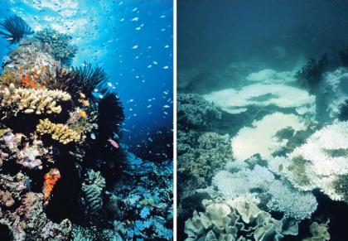
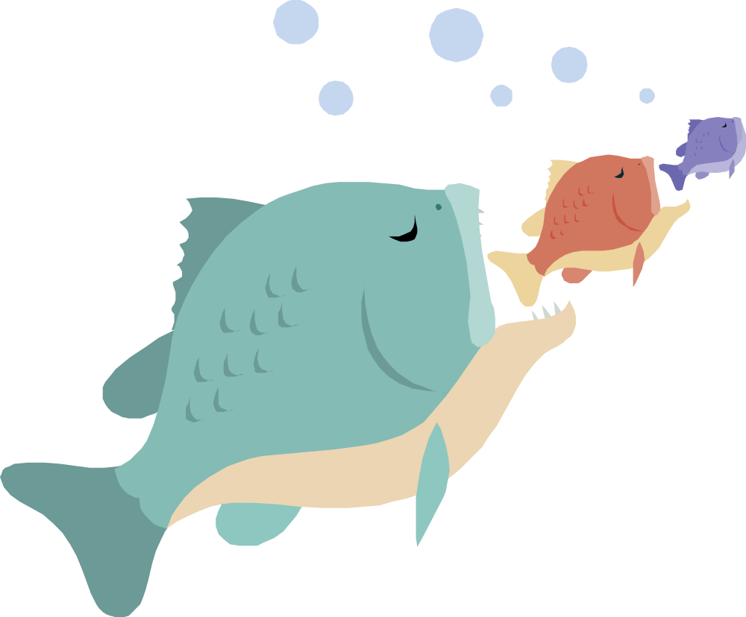




Ocean Acidification
Created by Eden Pan, Student Quest University Canada
Ocean acidification directly impacts marine shell animals, and in turn affects the entire marine ecosystem and humans.
Shell animals face the greatest challenge because their shells will form slower due to the lack of carbonate ions.
Those on top of the food chain like the orca whales will also feel the impact.
About one billion people in developing countries rely on fish as their primary food source. Acidification will cause food insecurity in those countries.
Fish and mammals like salmon and sea otters that feed on these shell animals will have a hard time surviving.
What is Ocean Acidification?
When the ocean absorbs carbon dioxide in the atmosphere, a chain of chemical reactions occur. These chemical reactions increase the ocean’s acidity and decrease the amount of carbonate ions, the building blocks for marine shell animals.
Originally, other natural chemical processes can neutralize ocean acidification. However, the rate at which we emit carbon dioxide into the atmosphere is accelerating ocean acidification.
Ocean acidification and other human industrial activities are killing coral reefs around the world.
How Can I Help?
Since carbon dioxide emission is the main cause for ocean acidification, you can help by doing the following:
Bike, use public transportation, carpool
Support renewable and efficient energy
Switch to a fuel-efficient car
3Rs: Reduce, Reuse, Recycle
Inform others about this issue
How Will it Impact British Columbia?
More than 15,000 people are employed in BC’s fishing industry. They contribute about $500 million to BC’s economy.
Ocean acidification will decrease the supply of major commercial shellfish (oysters, scallops), and eventually salmon, cod, herring and other commercial fish.
In fact, acidification has already killed millions of scallops along the BC coast.

