Slide 1
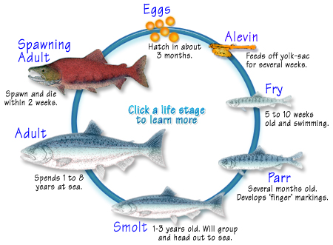
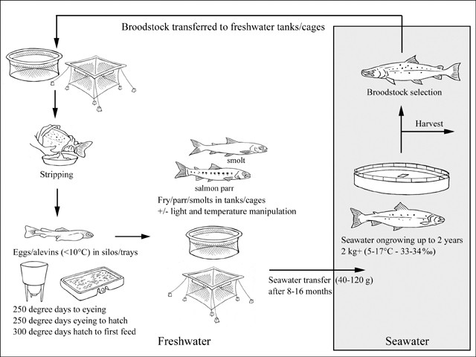
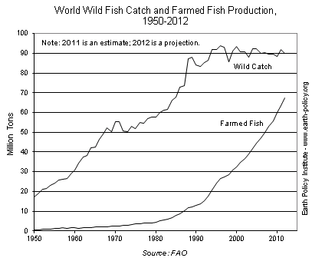
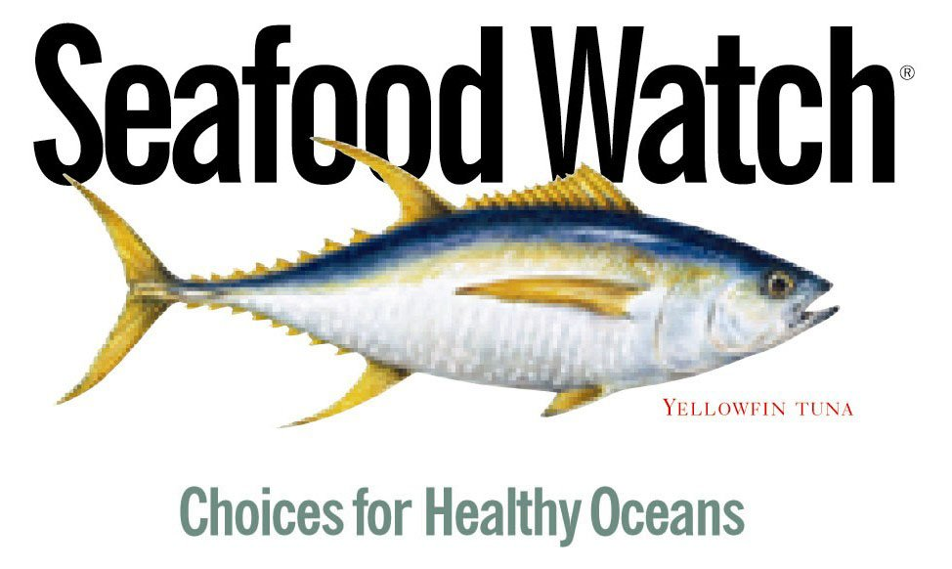
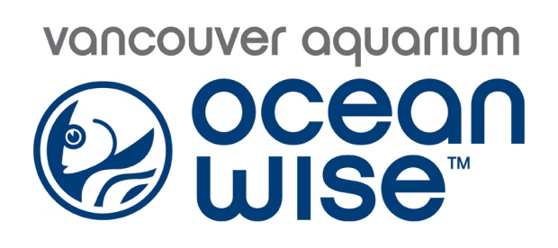


Where Did Your Fish Come From?
Wild – Salmon Life Cycle
Farmed – Salmon Life Cycle
Stress Factors
Overfishing
The demand for fish has steadily increased over the past 50 years, causing overfishing of wild fish, and posing a risk on marine biodiversity.
Due to overfishing of our wild supply, alternative solutions such as fish farming have increased over the past 50 years.
Sea Temperature Rise
Temperature changes can affect the growth, reproduction, behavior, and oceanic location of marine life
Figure 1
Figure 2
Risks involved with commercial fishing:
-Destruction of sea floor and coral reefs from Bottom Trolling and Dredges
-Bycatch will increase as the yield of commercial fishing increases
Ocean Acidification
Risks involved with aquafarming:
-The spread of disease and parasites
-The sediments of ocean pens can become anoxic
-Pollution of new genetics into wild habitats
-Chemical pollution from feeds and fertilizers
With an increase in pH levels, many eggs cannot survive. Ecosystems dependent on coral reefs will be affected as well as all shellfish species seeing a decline in population and quality.
Monterey Bay Aquarium has a downloadable consumer guide of the best and worst fish to eat – use the QR code for instant access!
Ocean Wise recognizes the impacts that both wild and farmed fishing can have. With over 585 partnerships across Canada, their main goal is to provide customers with fish from sustainable sources. Next time you go out to eat, look for their logo on the menu and choose sustainable fish if you can!
Best Choices:
-Salmon (Alaska)
-Pacific Cod (US hook/line)
-Prawns (Alaska)
-Albacore Tuna (Canadian/US troll/poll)
-Rainbow Trout (US farmed)
Avoid:
-Pacific Cod (Japan/Russia)
-Red King Crab (Russia)
-Squid (imported)
-Bluefin Tuna
-Mahi Mahi (imported)
Find out more about Ocean Wise with this QR code!
Created by: Jake Clugston, Quest University 2018
Figure 1: http://www.fishex.com/seafood/salmon/salmon-life-cycles.html, Figure 2: http://www.fao.org/fishery/culturedspecies/Salmo_salar/en,

