Slide 1
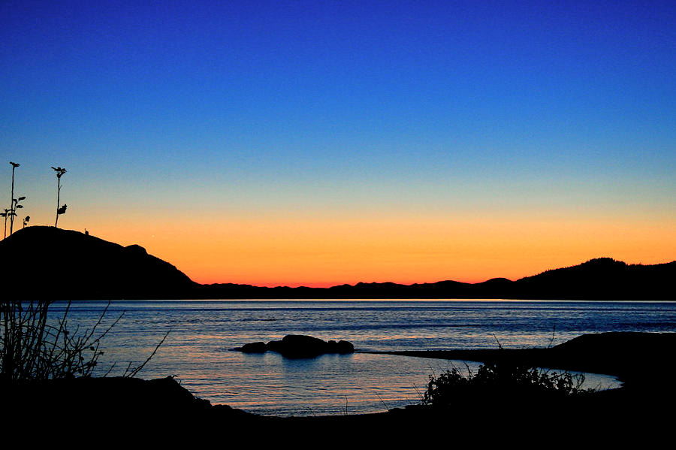
Howe Sound
Past ~ Present ~Future

Slide 2
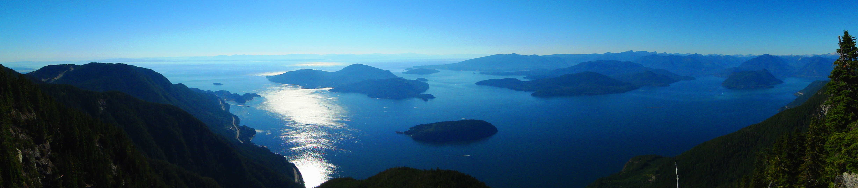
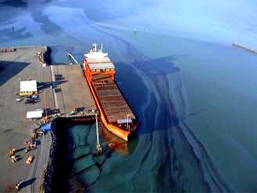
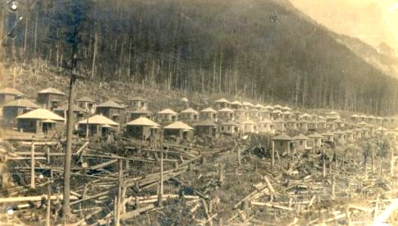
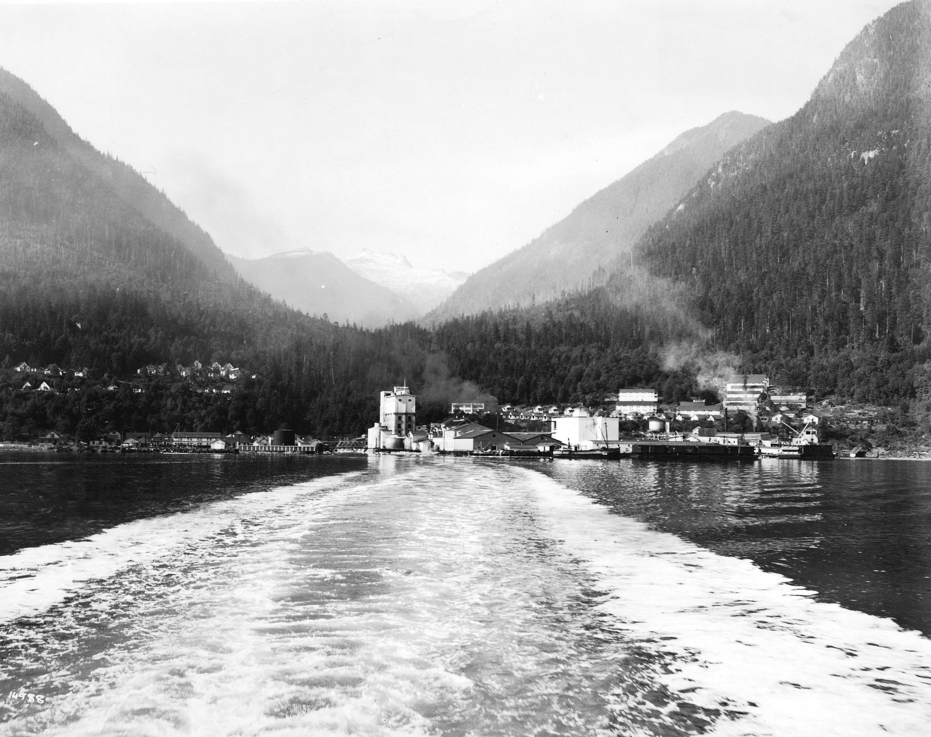
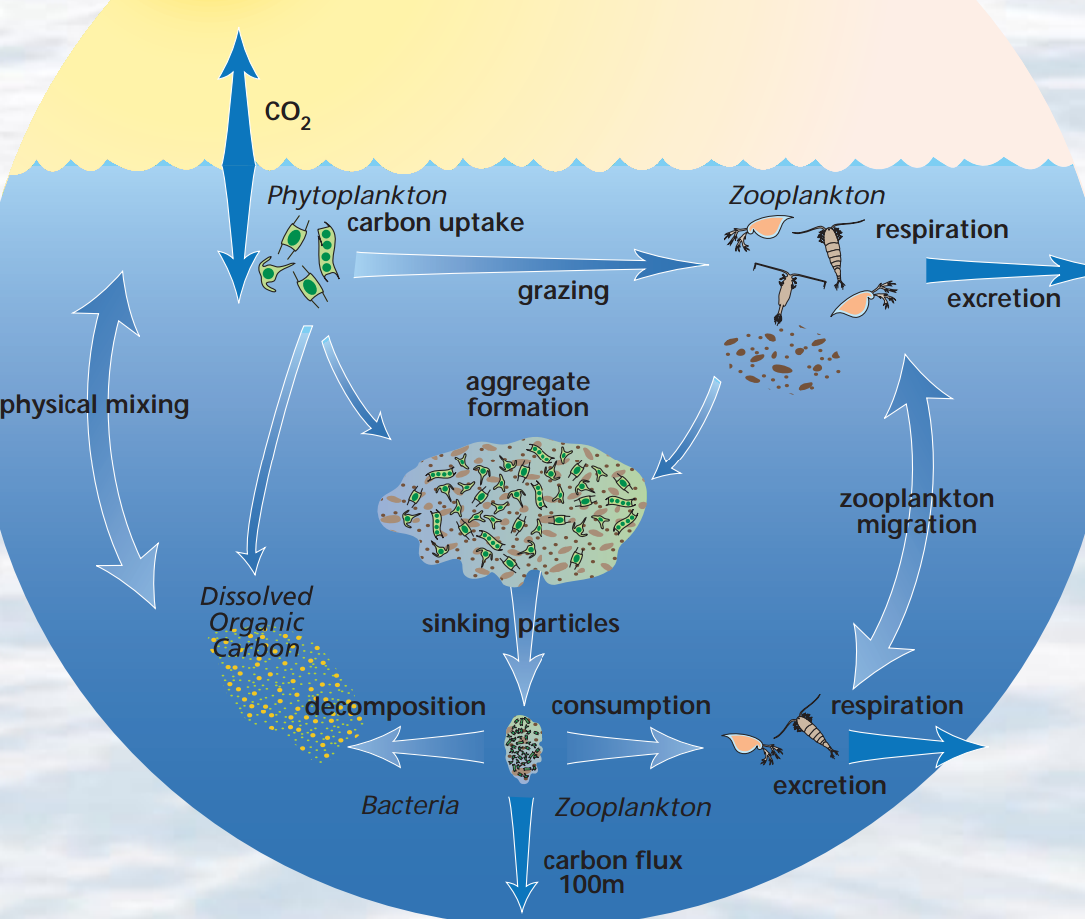
Howe Sound: Past Impacts
Howe Sound: Past Impacts
The Howe Sound region has been through several periods of ecologically exhaustive land use, but recent land stewardship and restoration of impacted areas has begun remediating this damage
Did you know?
150,000 tonnes of mercury-saturated sludge (enough to fill 3 Olympic swimming pools) had to be landfilled after the NEXEN chlor-alkali plant on the Squamish docks was shut down.(1999)
1
In 2006, a Gearbulk Ltd. Vessel leaks approx. 243 barrels of highly viscous Bunker C Oil into the Howe Sound.
2
In the 1930- 1950’s, the mining town of Mount Sheer, which has since abandoned, served as one of Brittania Mine’s established
‘company towns’
3
View of the Woodfibre plant (circa 1970’s) from Howe Sound. Biodiversity in the nearby area is still affected today.
Historic Land Use
Lasting Effect
Woodfibre and Port Mellon Pulp Mills. ( Woodfibre closed in 2006, Port Mellon is currently open as the Howe Sound Pulp & Paper Co.)
Brittania Copper Mine (closed 1974).
Nexen Chlor-Alkali Plant
(produced chlorine until 1991).
Degraded sea-floor sediment + hydrogen sulfide/methane emission deep into Howe Sound.
Requires daily removal of 700-800 Kg Leftover metal sludge from past mining.
Left the Howe Sound ecosystem with close to toxic levels of mercury concentration.
4
Bouncing Back:
What Was Done:
As scientists began to asses the effluent (runoff) flow from many of the older industrial operations, they saw lower levels of biodiversity, species productivity, and pH levels. This publicity led to a growth in public knowledge of harmful practices and subsequent phasing out of many polluting operations. Today, the size of the oceanic “dead zone” caused by Howe Sounds heavy industrial period has been greatly diminished.
http://www.env.gov.bc.ca/eemp/incidents/2006/westwood_06.htm
http://globalnews.ca/news/1419568/ghost-town-mysteries-the-swimming-pool-of-mount-sheer-b-c/
http://searcharchives.vancouver.ca/view-of-wood-fibre-plant-from-howe-sound
http://cmore.soest.hawaii.edu/cruises/operex/sutton_blog.htm

Slide 3
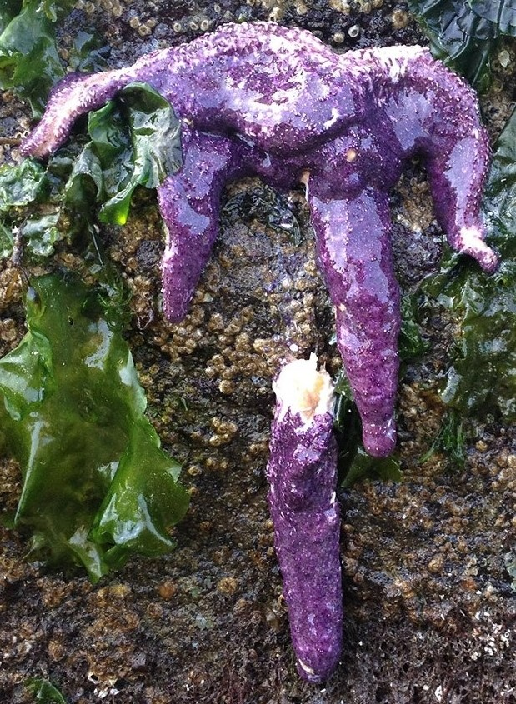
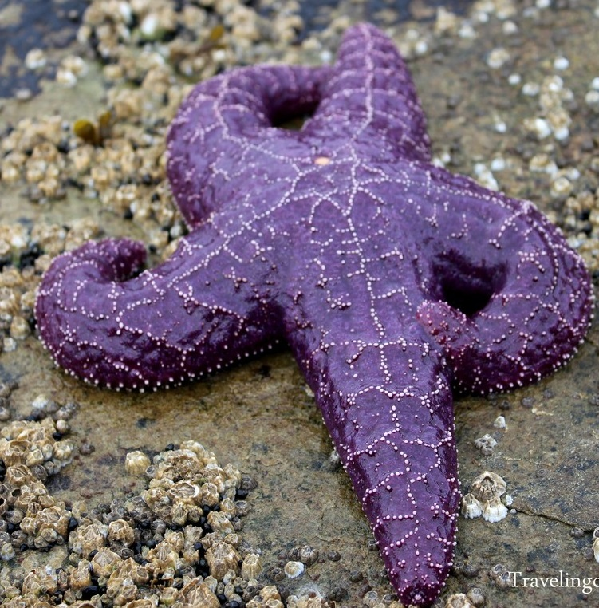
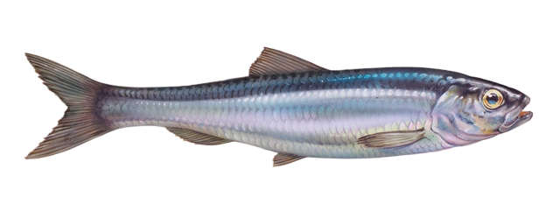
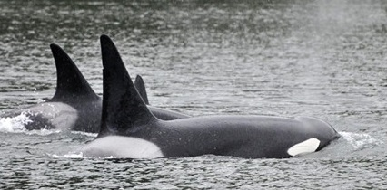
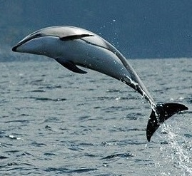
Howe Sound: Present Day
1
Howe Sound is the southernmost fjord in North America. It is a beautiful ecosystem thriving with life, but it came from restoration and hard work, and more still needs to be done…
The Return of Pacific Herring
Sea Star Wasting Syndrome
Did you know?
The sea star is a keystone species in the marine food web, meaning they play a large role in the structure of the ecological community
Pacific herring populations were so low that the commercial fisheries had to be shut down in the 1980’s. Howe Sound herring populations were also low from pollution and destruction of spawning habitat.
A volunteer group called the Squamish Streamkeepers found that herring were unsuccessfully spawning on toxic pilings under docks in Howe Sound. In 2006, they started wrapping the pilings with an enviroliner to stop the toxins from killing the eggs. There has since been an increase in the herring population, as millions of eggs are able to hatch every year.
This increase in the herring population in has drawn some of its larger predators back to Howe Sound, including orcas and porpoises.
Did you know?
Pacific herring are a cornerstone species in the marine food web, meaning they support many different species
4
5
5
Sea stars play a large role in marine ecosystems by eating species that have no other predators, such as sea urchins and mussels. In 2013, a disease started to rapidly spread among sea stars, giving them lesions on their legs and causing them to turn to goo and die.
Scientists have identified the virus that is causing the disease, but do not know how to treat it. They also hypothesize that warmer water makes it easier for the disease to spread. Howe Sound has been hit with this disease, and it could change the ecosystem balance as species lose their predators and grow in population, reducing their prey’s population.
2
3
1: https://cronkyski.wordpress.com/2014/09/07/st-marks-summit-cypress-provincial-park/
2: http://bowenislandkayaking.com/bisk/orcas-return/
3: http://www.vanaqua.org/act/direct-action/bc-cetaceans-sighting-network
http://vancouvertrails.com/blog/wp-content/uploads/2013/03/
4: http://bicyclebuddha.org/my-heart-is-with-the-starfish/
5: http://www.macleans.ca/society/science/b-c-starfish-are-dissolving-into-goo/

Slide 4
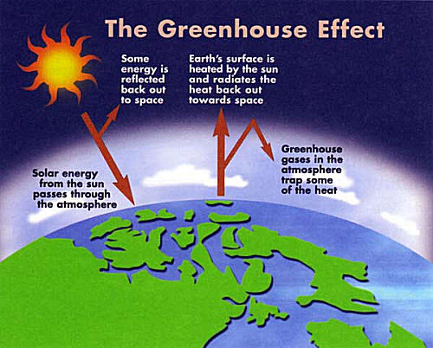
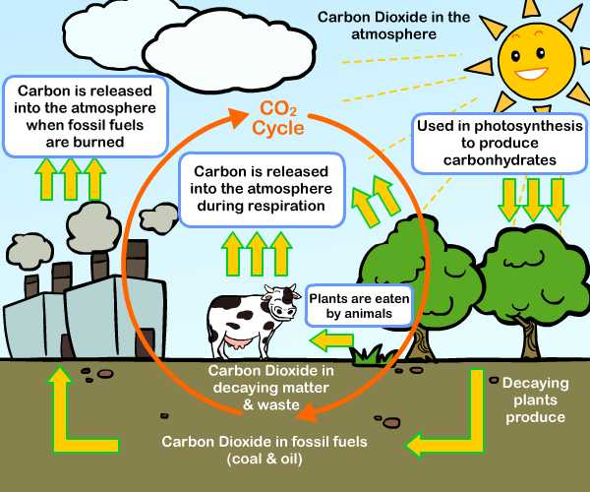
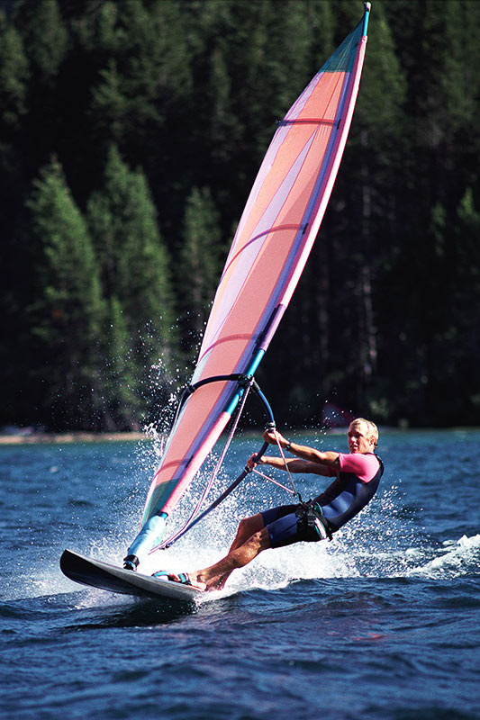
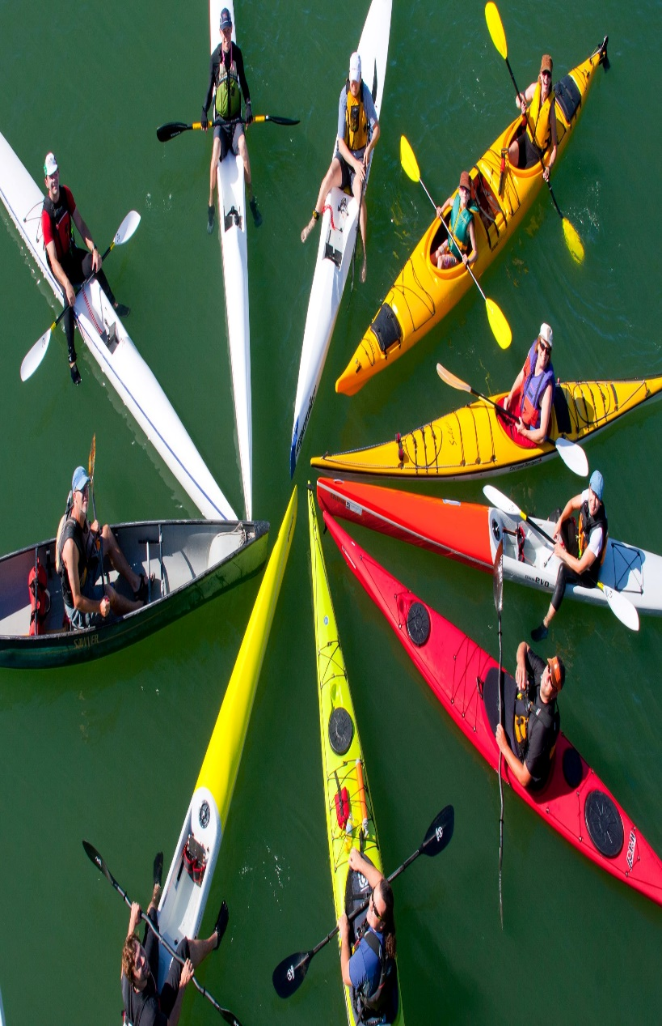
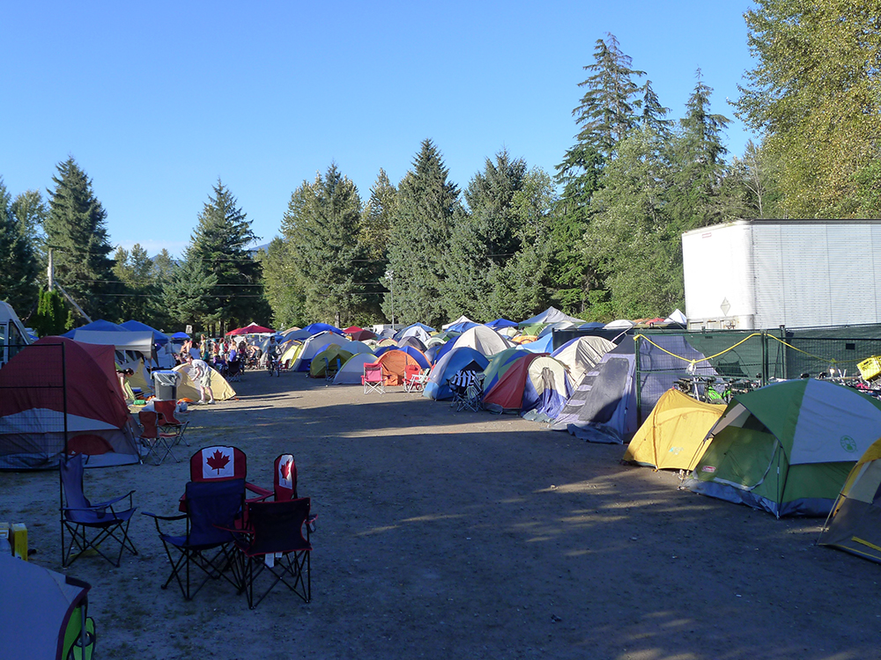
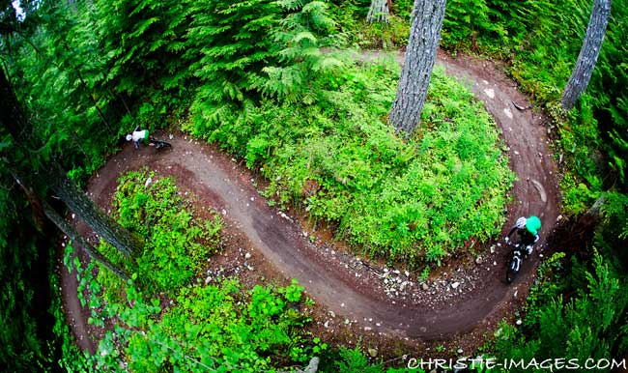
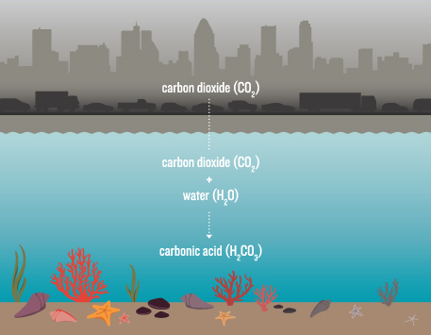
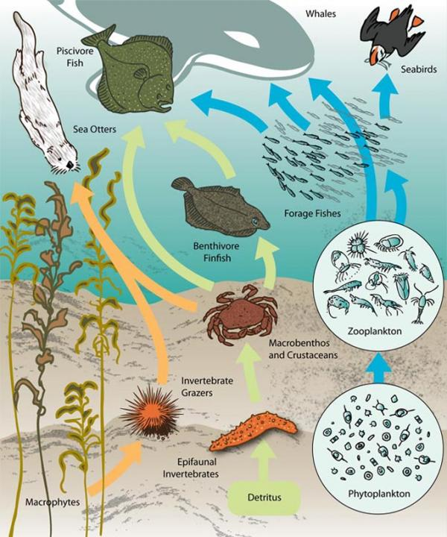
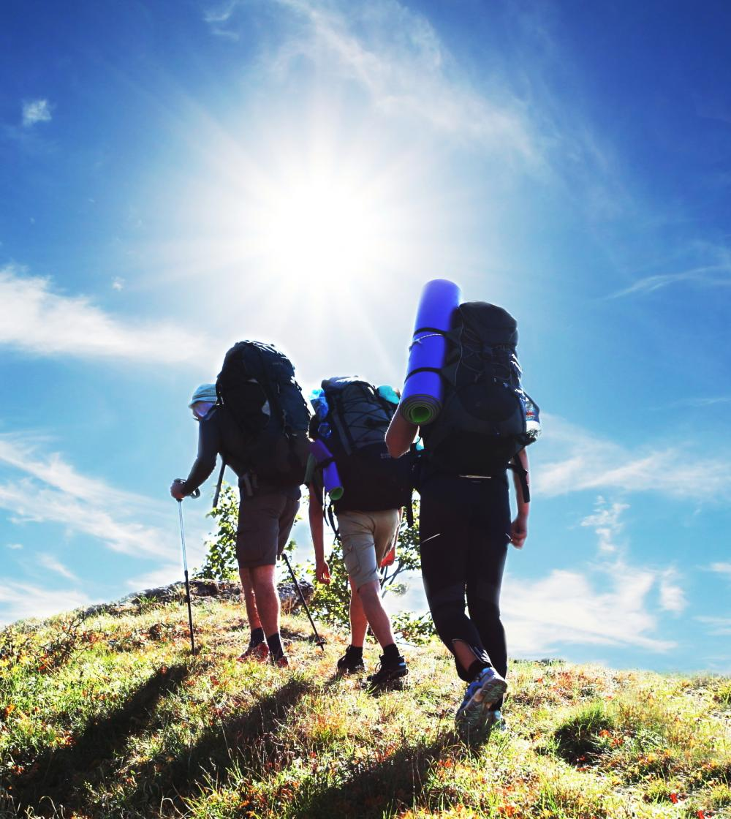
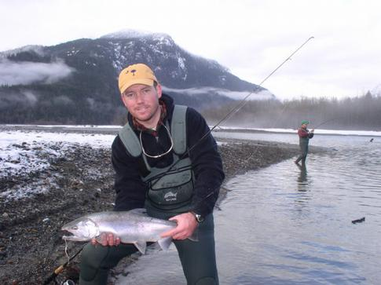
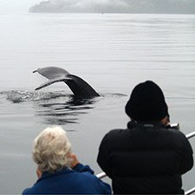
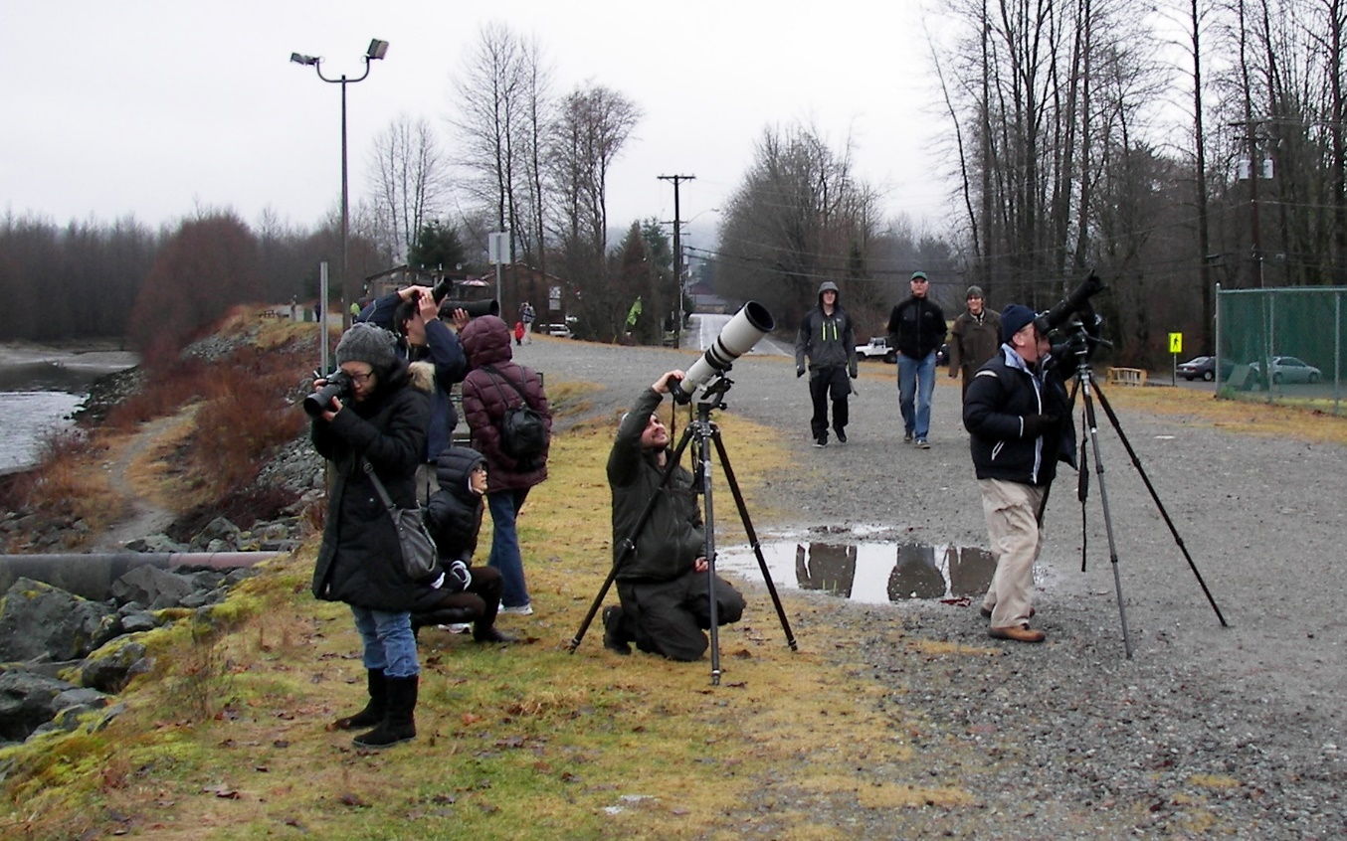
Howe Sound: Future Outlook
The future prosperity of the Howe Sound ecosystem relies entirely on our continued efforts to protect and safeguard our environmental heritage.
Current Future Projections
(If industrial productivity continues at the rate it is at)
Ensuring a Green Future
(Through the diversification and promotion of ecotourism)
Did you know?
Squamish is the outdoor recreational capital of the Canada. Attracting about 2.4 million tourists who, on going up and down the Highway 99 every year, drop 1.4 BILLION DOLLARS into the economy of Squamish and Whistler.
NOTE: Ocean Acidification and Marine Biodiversity Loss are among same of the major impacts the current rate of industrial activity could potentially have on the recovering Howe Sound marine ecosystem if left unchecked to meet the Squamish community standards.
Ocean Acidification reduces levels of calcium carbonate – an essential chemical building block in the formation of shellfish and coral reefs. Consequently, marine food chains risk total collapse hence threatening the existence their entire marine ecosystem.
Carbon dioxide (CO₂) is a prominent greenhouse gas. It readily dissolves in ocean waters by reacting to form carbonic acid, which quickly raises the water pH causing the ocean water to become more and more acidic. This occurrence becomes more frequent with increasing CO₂ concentrations in the atmosphere.
Sources
*http://www.squamishreporter.com/2014/06/07/heavy-industry-and-tourism-dont-mix-says-anti-lng-activist/#.VRIjo_nF91Y
*http://www.gibsonschamber.com/pdf/BCIT-DSF-Study-Aug2014.pdf
*http://sustainablehowesound.ca/wp-content/uploads/2013/09/rpt_baseline_howesoundpark_v5_20130731.pdf
*http://en.wikipedia.org/wiki/Greenhouse_effect
*All images retrieved from Google IMAGES
*Shttp://en.wikipedia.org/wiki/Squamish,_British_Columbia
*http://www.hellobc.com/squamish/culture-history.aspx

