Slide 1




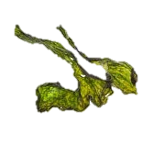
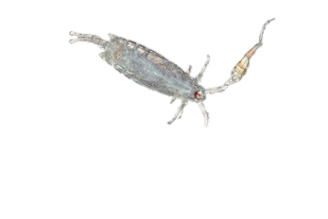
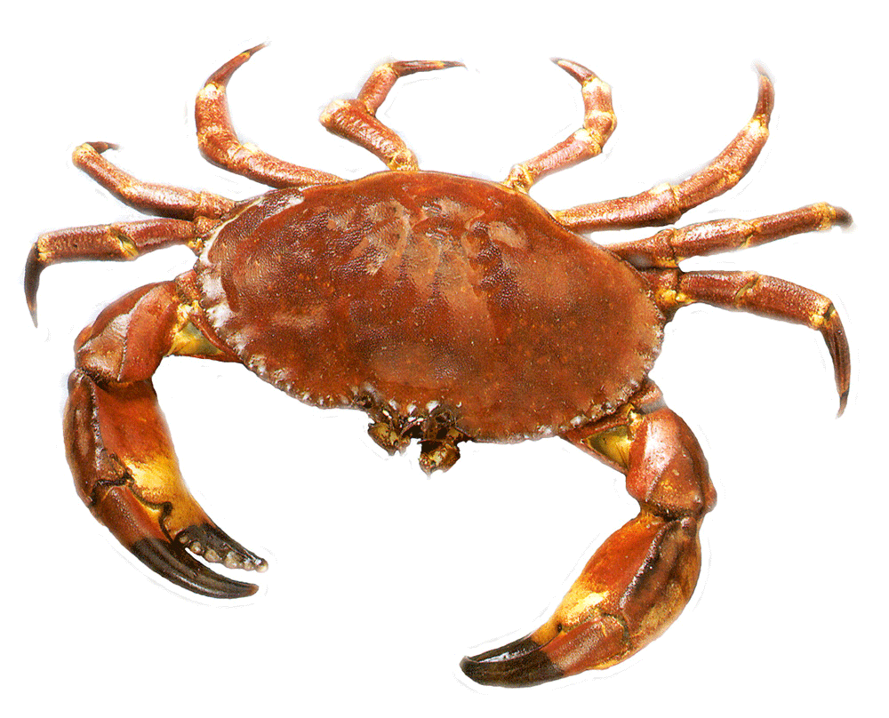
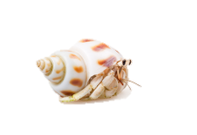
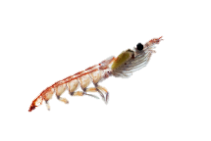
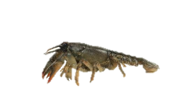


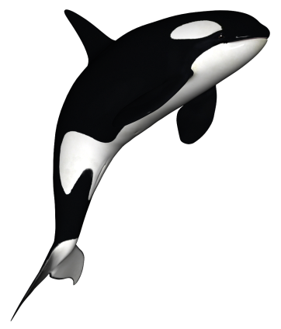
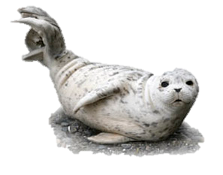
Marine Food-Web
The Ocean is Sensitive
The ocean is a diverse and curious place. The ecosystem within the vast ocean is a sensitive balance. Anything that disturbs one level of the food web, may have severe impacts on all other levels.
Plankton
Threats: Ocean Acidification
Algae
Carbon dioxide (CO₂) in the atmosphere gets absorbed into the oceans. This lowers the pH of the water and makes the water more acidic. As the water gets more acidic, it makes it more difficult for these organisms to survive.⁽¹⁾
What exactly does ocean acidification do to organisms?
The acid in the water dissolves the shells on different organisms like crustaceans. With weaker shells, it decreases their chances of survival. This affects all levels of the food-web in two different ways: with fewer crustaceans in the ocean, there is less food for other animals. Crustaceans also eat smaller creatures and with their numbers dwindling, there is an over-supply of small organisms, which reduces the amount of phytoplankton and algae in the oceans. ⁽²⁾ Ocean acidification also affects the survival of fish. The acidic waters makes it harder for fish fry to develop, making it more difficult for the fish to become adults and thrive. ⁽³⁾
Crustaceans
Medium Fish
Small Fish
Solution: What can we do?
An easy way we can all reduce the amount of CO₂ we put in the atmosphere is to take public transit. Taking the bus in an effective and easy way we can all contribute to slowing down climate change and ocean acidification. Being mindful of our individual carbon footprint is very important, however , the people who can make the biggest difference are those who own businesses. Support the local businesses that minimize their carbon footprint and embrace the environmental movement. If we all work together, we have the power to save our oceans.
This sign was created by Ricky Souza, Quest University Canada, Class of 2016.
Sources
Large Mammals
Medium Mammals
1) Sabine C, 2014. Carbon Dioxide in the Ocean and Atmosphere. Waterencyclopedia.com.
2) Fabry, V., Seibel, B., Feely, R., & Orr, J. (2008). Impacts of ocean acidification on marine fauna and ecosystem processes. ICES Journal Of Marine Science, 65(3), 414-432. doi:10.1093/icesjms/fsn048
3) Painting, R. (2011). Ocean Acidification Is Fatal To Fish. Skeptical Science. Retrieved 24 March 2015, from http://www.skepticalscience.com/Ocean-Acidification-is-Fatal-To-Fish-.html

