Slide 1
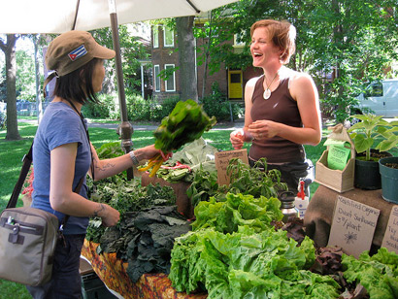
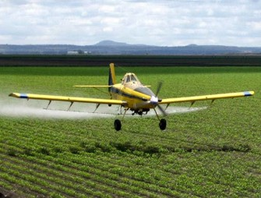
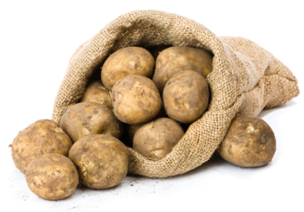


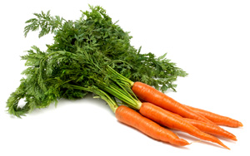

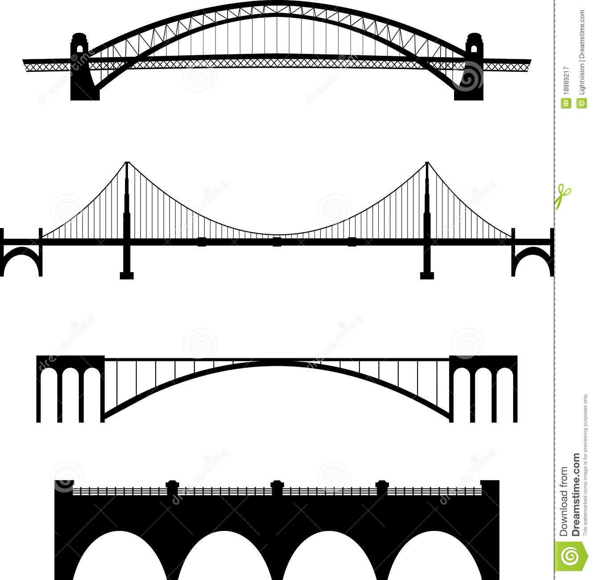
Power of Food
Seize your power as a consumer! See the impact your food purchases can have.
Should I Buy….
Local
Global
Support small/family farmers over commercial growers.
Reduce food miles (less emissions in transportation).
Encourage a self sufficient community.
Both
Areas can specialize in production.
Build good trade relations with other countries.
Less expensive.
Large variety to choose from.
Food supply less vulnerable to climate change driven extreme weather patterns
Good balance of pros and cons.
Consumer Choice !!
How the Environment is Shifting the Strategy of Agriculture
How We Can Impact the Environment With Agriculture
Local | Global
Adjustment of irrigation systems according to water availability. | Specialization becoming necessary with shifts in climate.
Adjustment of crops grown in an area.
Local | Global
Increase carbon stores in soil and vegetation. | Universal, collaborative agriculture policy
Diversify Crop cover to replace agrochemicals | Institutional funding supporting mitigation

