Slide 1


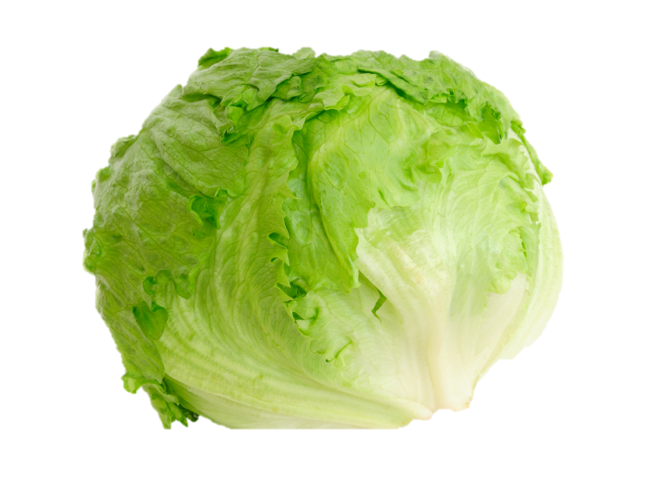

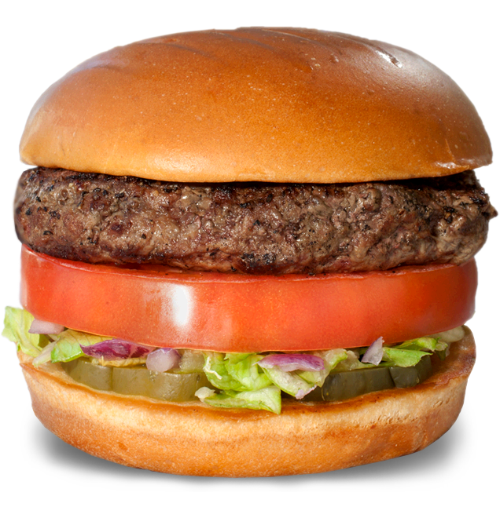
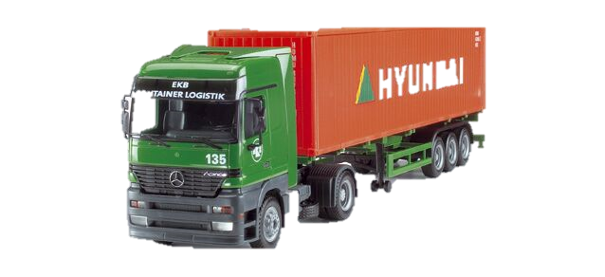
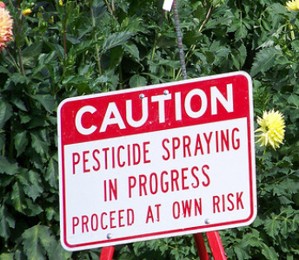



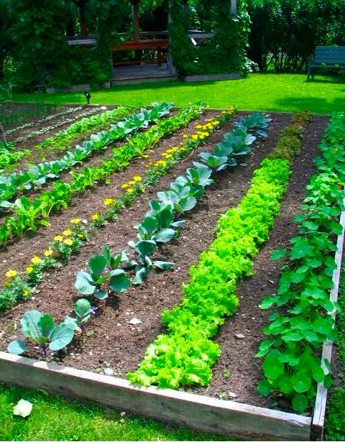
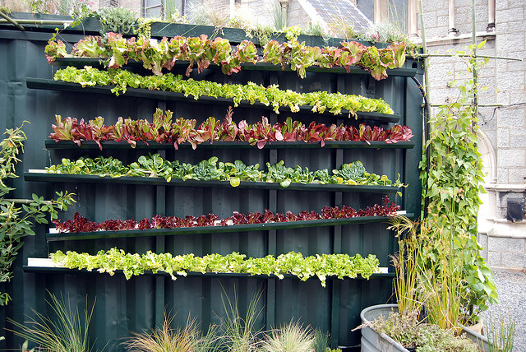
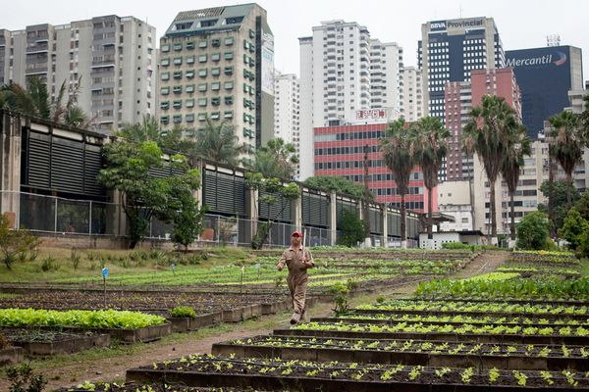

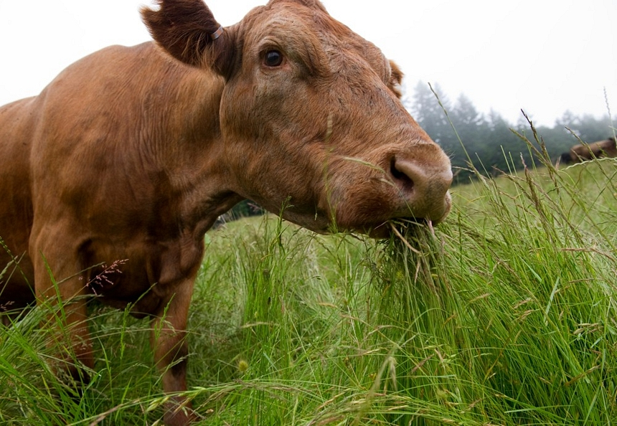
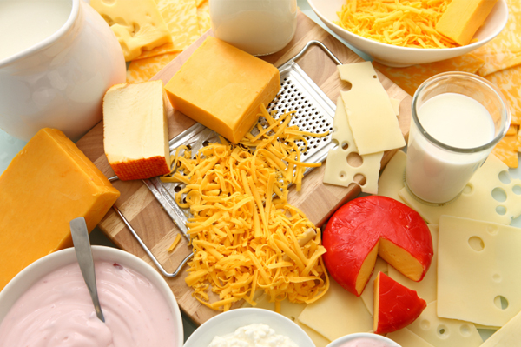
EATING LOCAL?
IF NOT, What is the real cost of your food?
How much water is used?
How far is your meal travelling?
The average water footprints for:
Potato chips 1040L/kg
Lettuce 240 L/kg
One egg 200 L
Tomatoes 50 L
Ketchup 530 L
Milk 1020 L/kg
Kaiser bun 40 L
One beer 74 L
An apple 125 L
Beef 15400 L /kg
Canadians 343 L/day
Americans 382 L/day
1 Toilet flush 20L
The average meal travels 1200 km from farm to plate
Transportation makes up about 25% of greenhouse gas emissions in Canada and the US
BC is very reliant on importing food. By producing food locally and sustainably, it reduces environmental impacts. As the climate changes, BC must be ready to adapt and grow more food
Helping is as easy as..
Grow from home
Support urban farming
Buy locally produced foods
Be water conscious
Eat less meat per week, or meat that is organically grown or grass fed
Reduce dairy
Connor.Heinrichs@questu.ca
http://www.davidsuzuki.org/what-you-can-do/food-and-our-planet/food-and-climate-change/

