Slide 1




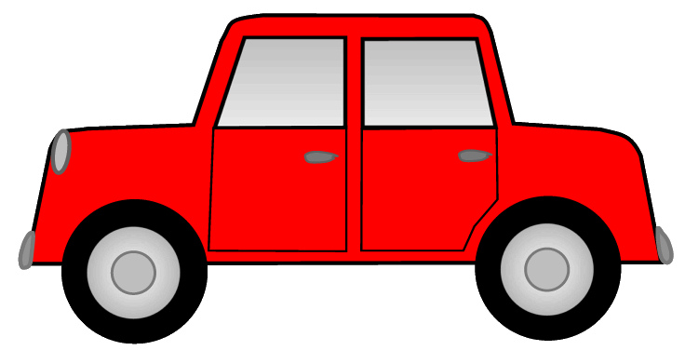

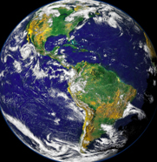

Carbon Here, Carbon There, Carbon Everywhere!
The Terrestrial Carbon Cycle
Want to learn about carbon??
Follow me!
4. Fossil Fuel
Combustion
Fossil Fuel Combustion
6 Pg
1. Photosynthesis
Fossil fuel combustion releases carbon dioxide. As seen in this diagram, photosynthesis extracts 120 Pg of carbon from the atmosphere, which is then returned through the process of respiration. This cycle becomes imbalanced by the addition of 6 Pg from fossil fuel combustion, which leads to an excess of carbon in the atmospheric.
Plants use sunlight energy, carbon dioxide and water to conduct the process of photosynthesis, which produces sugar and oxygen (1). Photosynthesis is essential to the extraction of carbon dioxide from the atmosphere, and the addition of oxygen. Forests and the terrestrial ecosystem are a necessary part of the carbon cycle, storing approximately 2,000 Pg of carbon (2).
Photosynthesis
120 Pg
Plant Respiration
60 Pg
Animal and Soil
Respiration
60 Pg
Petagrams (Pg) = Billions of Tons of Carbon
Oxygen
2. Plant Respiration
3. Animal and Soil Respiration
All living things derive energy from respiration. Plants use sugar, and oxygen to conduct the process of respiration, which produces carbon dioxide, water, and energy (1). Respiration is essential for plants to live, but it is also one of the primary ways carbon returns to the atmosphere.
Animals and soil organisms respire, producing carbon dioxide. Together, plant, animal, and soil respiration releases the same amount of carbon that photosynthesis extracts from the atmosphere. 1,500 Pg of the 2,000 Pg in terrestrial ecosystems resides in soil, making it vital to carbon storage (4).
Why do we care?
What can we do to diminish our emissions?
This graph shows temperature and carbon dioxide over time
Carbon dioxide is a greenhouse gas that absorbs and re-emits thermal radiation, which warms the Earth. As the graph shows, human activity has lead to an increase of atmospheric carbon, which will subsequently raise temperatures. Warmer temperatures in the future will lead to significant climate changes that will effect humans and all other species (3).
Support decisions to reduce global carbon dioxide emissions.
Conserve the forest and plant more trees and vegetation.
Seek alternative modes of transportation that minimize emissions.
References
Keller, M. (2015). ScienceDirect, 125-143.
2. McCarl et al. (2006) Climatic Change.
3. Wigley et al. (2000). The Carbon Cycle.
4. Schlesinger et al. (2000) Jstor, 48 (1), 7-20.
Poster by Anya Kazanjian,
Quest University, Class of 2018
http://johnenglander.net/sites/default/files/images/CO2-Temperature%20420%20kyr.gif

