Slide 1





A pedagogical framework for team-based interdisciplinary doctoral education:
The University of Idaho IGERT Model
Zion Klos,
University of Idaho
Michael O’Rourke,
Michigan State University
Nilsa Bosque-Perez,
University of Idaho

Slide 2

Overview
The NSF’s IGERT program:
  Aims and Overview
Pedagogical Frameworks
  Integrative Doctoral Models
  Idaho Model
  Improved Future Model
Broader Implications for Higher Education
  Undergraduate Education
Integrative Sciences
Academia

Slide 3
IGERT OVERVIEW

Slide 4
THE NSF’S IGERT PROGRAM
National Science Foundation’s (NSF’s)
Integrative Graduate Education and Research Traineeship (IGERT)
“catalyze a cultural change in graduate education, for students, faculty, and institutions, by establishing innovative new models for graduate education and training in a fertile environment for collaborative research that transcends traditional disciplinary boundaries”
IGERT Overview - Doctoral Models - Idaho Model - Improved Model - Implications
Notes:
mention that I am an IGERT student…I am one of the guinea pigs!

Slide 5
IGERT Program Overview
Doctoral education
From 1998 to present
  6,500 PhD students
  278 grants awarded to institutions
    ~24 students per grant
  approximately $3.0-3.6 million for a 5 year program
Types of IGERTs
  Value-added IGERTs
  Integral IGERTs
IGERT Overview - Doctoral Models - Idaho Model - Improved Model - Implications

Slide 6
IGERT Program Overview
Some example titles from nearby in MI:
  Biosphere-Atmosphere Research and Traineeship, UM
  A Unified Approach to Sequential Decision-Making in Cognitive Science, MSU
  Interdisciplinary Traineeship in High Performance Computing Applications, Wayne State Univ.
www.igert.org
IGERT Overview - Doctoral Models - Idaho Model - Improved Model - Implications
Notes:
-make spaces

Slide 7
PEDAGOGICAL MODELS FOR DOCTORAL EDUCATION

Slide 8

INTERDISCIPLINARY PEDAGOGICAL FRAMEWORKS
The mode of graduate education is changing and educators need frameworks to base their curricula upon
Constructive alignment of framework (Borrego and Cutler, 2010)
  Learning Objectives
  Learning Experiences
  Learning Assessment
IGERT Overview - Doctoral Models - Idaho Model - Improved Model - Implications

Slide 9
KEY LEARNING OBJECTIVES
Broad perspective and disciplinary strength
Skills in team-based research
Interdisciplinary communication skills
Creative problem-solving skills
Philosophical understanding
Jones et al., 1999; Graybill et al., 2006; Manathunga et al., 2006; Mitchell et al., 2009; Borrego and Cutler, 2010
IGERT Overview - Doctoral Models - Idaho Model - Improved Model - Implications

Slide 10
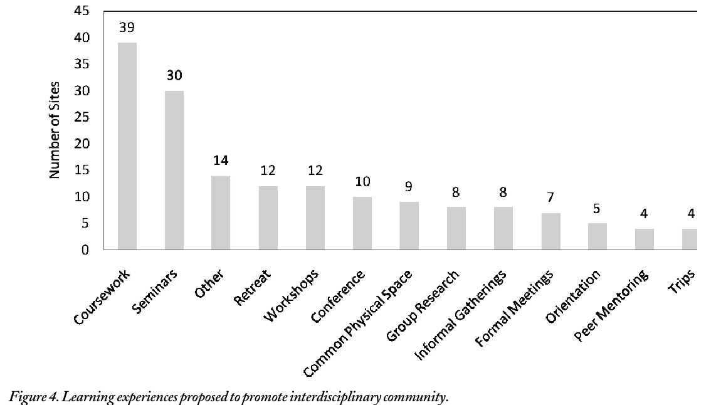
COMMON LEARNING EXPERIENCES
Interdisciplinary broadening and community building experiences
Borrego & Cutler, 2010
n = 118
IGERT Overview - Doctoral Models - Idaho Model - Improved Model - Implications
Notes:
Other = ? …manuscript doesn't elaborate

Slide 11
LEARNING ASSESSMENTS
Be Well Grounded in the Disciplines
Improvements needed in assessment (Borrego and Cutler, 2010)
Interdisciplinary Student Work should:
Advance Student Understanding
Boix Mansilla & Duraisingh, 2007
Show Critical Awareness of the Process
IGERT Overview - Doctoral Models - Idaho Model - Improved Model - Implications

Slide 12
THE “IDAHO MODEL” FOR DOCTORAL EDUCATION

Slide 13
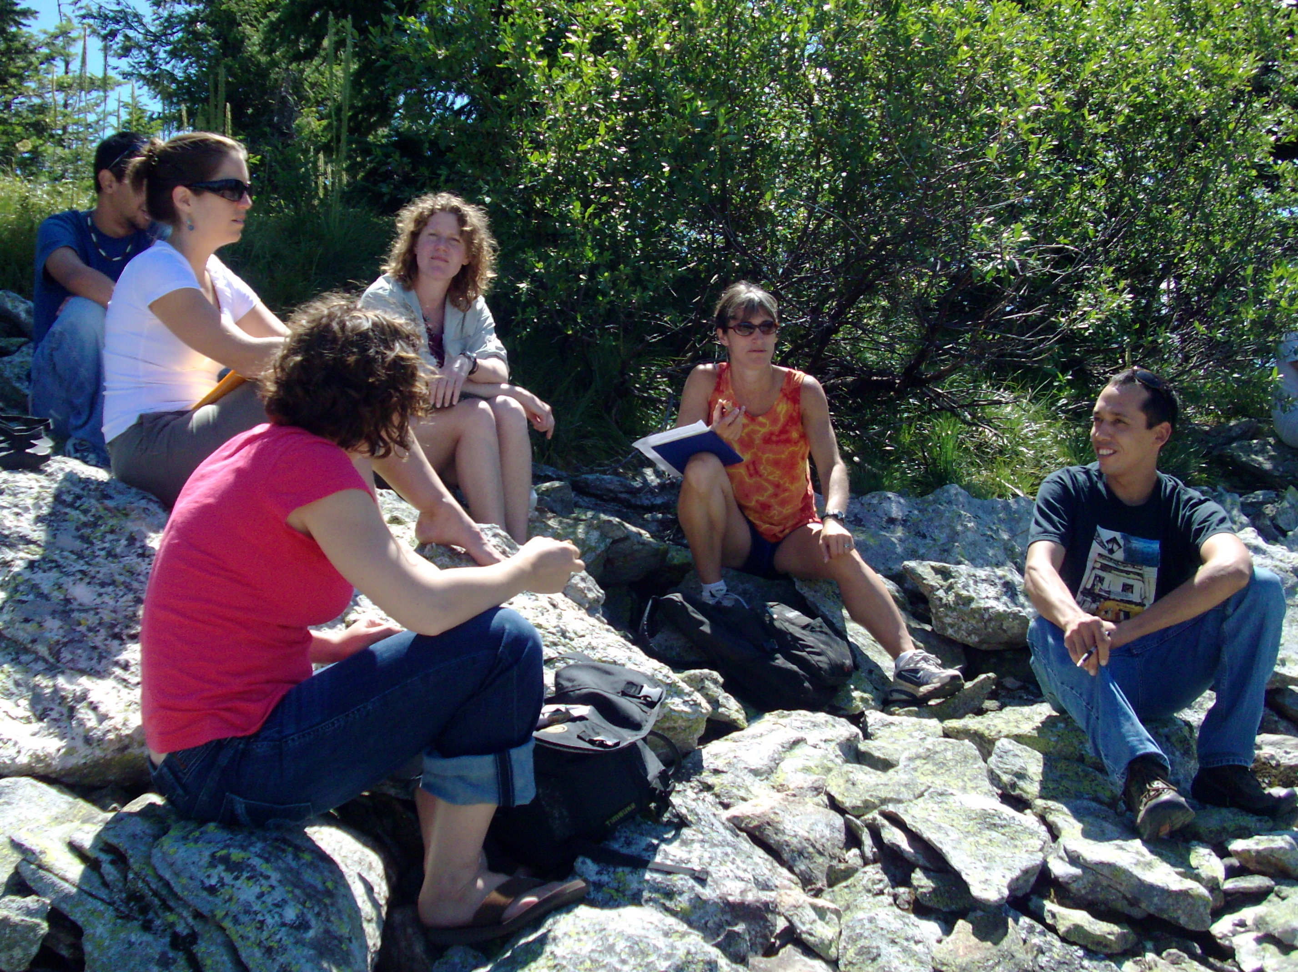
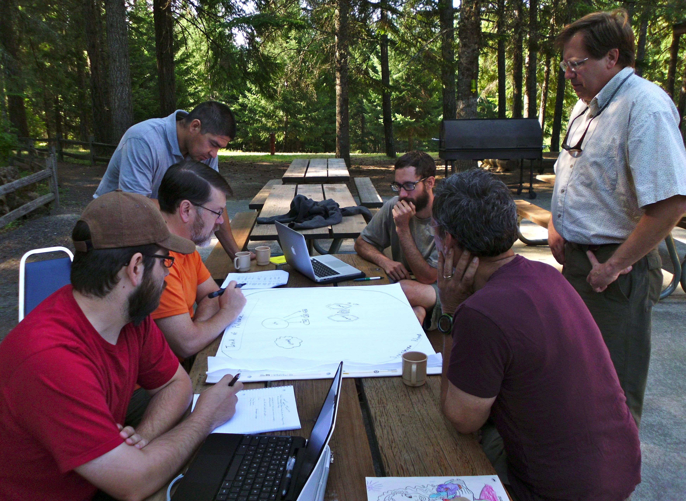
IDAHO’S IGERT, QUICK OVERVIEW
Focused on sustainability/resilience of social-ecologic systems
2001 and 2009 grants
  18 and 24 students, respectively
2009 IGERT, 6 teams, 4 students each
  3 Idaho-based teams
  3 Costa Rica-based teams
Teams chosen by faculty, designed to address interdisciplinary problems
Social, ecological, and physical sciences – depth and breadth
IGERT Overview - Doctoral Models - Idaho Model - Improved Model - Implications

Slide 14
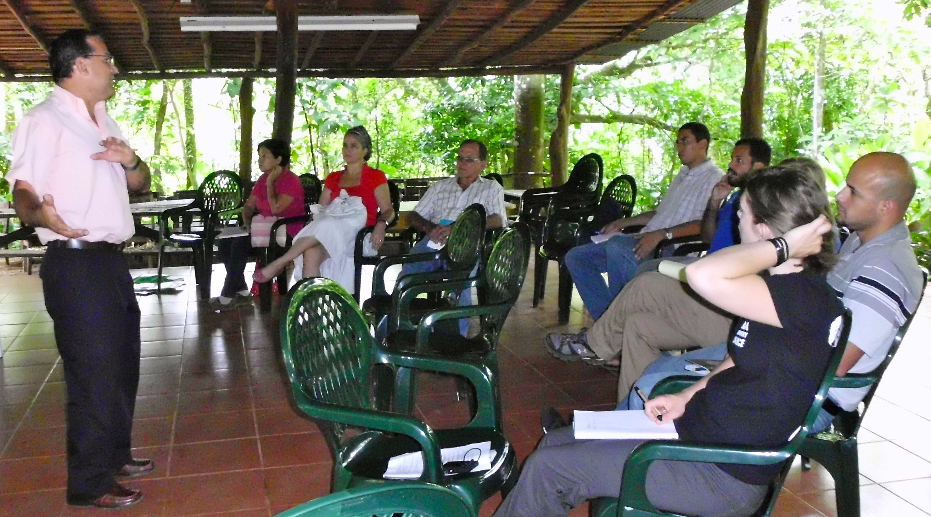
THE “IDAHO MODEL”:
LEARNING OBJECTIVES
Interdisciplinary teamwork
Interdisciplinary communication
Broad and focused knowledge
Solve problem-based questions
Effectively conduct community outreach
IGERT Overview - Doctoral Models - Idaho Model - Improved Model - Implications
Notes:
-maybe add cultural awareness

Slide 15
THE “IDAHO MODEL”:
LEARNING EXPERIENCES
Introductory immersion course (field based)
Team-based research
ID communication skills and philosophy (Toolbox, Eigenbrode et al. 2007)
Coursework and seminars (e.g. Interdisciplinary Methods)
Annual presentations (individual & group)
Retreats, conferences, & group travel
Socialization (formal & informal)
Common workspaces
IGERT Overview - Doctoral Models - Idaho Model - Improved Model - Implications
Notes:
-fix ID wording

Slide 16
THE “IDAHO MODEL”:
LEARNING EXPERIENCES
Borrego & Cutler, 2010
Idaho IGERT Components
IGERT Overview - Doctoral Models - Idaho Model - Improved Model - Implications
Notes:
-need to circle things on bottom…and say Idaho IGERT in red or something

Slide 17
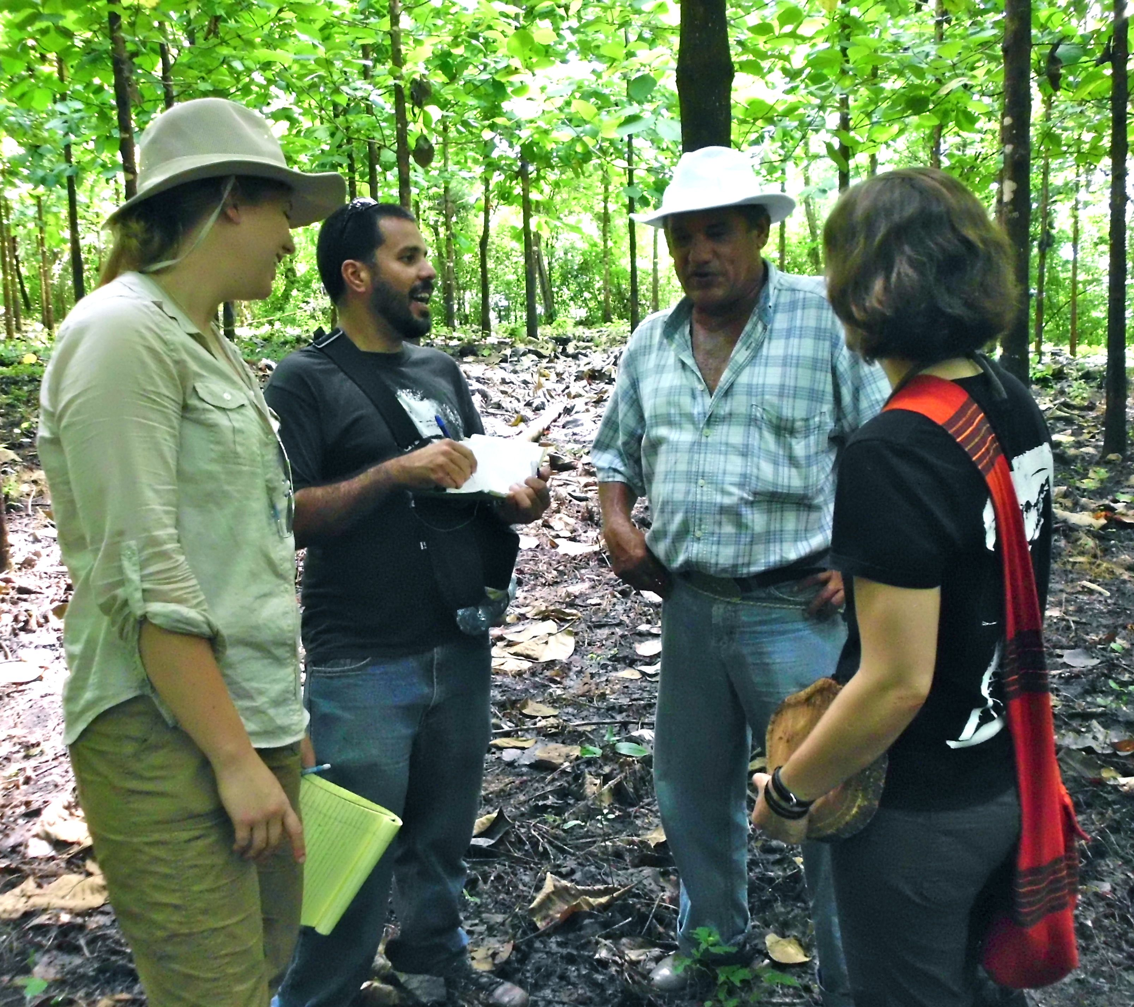
THE “IDAHO MODEL”:
LEARNING ASSESSMENT
Disciplinary and IGERT requirements
Interdisciplinary publications
Interdisciplinary dissertation committees
  Interdisciplinary dissertation chapter
  Interdisciplinary preliminary exam
Coursework feedback/grading
Proposal presentation feedback
Outreach and public feedback
IGERT Overview - Doctoral Models - Idaho Model - Improved Model - Implications

Slide 18
IDAHO MODEL AT ITS CORE
Our educational model develops interdisciplinary team members that can work with other disciplines rather than a single individual capable of doing research in multiple disciplines.
Breadth
sociology climatology
ecology geology
“T-shaped Individual”
Depth
hydrology
IGERT Overview - Doctoral Models - Idaho Model - Improved Model - Implications

Slide 19
IDAHO MODEL AT ITS CORE
Our educational model develops interdisciplinary team members that can work with other disciplines rather than a single individual capable of doing research in multiple disciplines.
Breadth
science of teamwork
systems thinking
Depth
Depth
Depth
Depth
“T-shaped Individual”
Depth
Depth
pedagogy
Depth
“Shield-shaped Individual”
ecology
sociology
geology
hydrology
IGERT Overview - Doctoral Models - Idaho Model - Improved Model - Implications

Slide 20
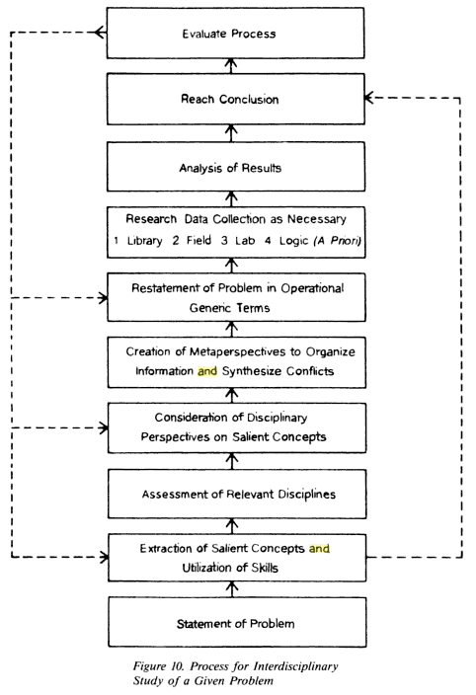
IDAHO MODEL CHALLENGES
Klein, 1990
Repko, 2008
Define the problem
Justify using an ID approach
Identify relevant disciplines
Discover what is already known of the problem (lit review)
Develop adequacy in each discipline
  Epistemology
  Assumptions
  Concepts
  Theories
  Methods
Analyze the problem with your gained ID insights
Understand conflicts between gained insights
Create common ground on insights
Integrate insights
Test integrated insights
IGERT Overview - Doctoral Models - Idaho Model - Improved Model - Implications

Slide 21
IDAHO MODEL CHALLENGES
Klein, 1990
Repko, 2008
0. Find a problem to fit disciplines
Define the problem
Justify using an ID approach
Identify relevant disciplines
Discover what is already known of the problem (lit review)
Develop adequacy in each discipline
  Epistemology
  Assumptions
  Concepts
  Theories
  Methods
Analyze the problem with your gained ID insights
Understand conflicts between gained insights
Create common ground on insights
Integrate insights
Test integrated insights
Bad Problem
Changing Disciplines
Find problem to fit disciplines
IGERT Overview - Doctoral Models - Idaho Model - Improved Model - Implications

Slide 22
IDAHO MODEL CHALLENGES
Difficulty locating the “best” team problem to focus on for the duration of the PhD
Lack of accompanying institutional degree program
Team misalignment at a fundamental level due to lack of philosophical background
IGERT Overview - Doctoral Models - Idaho Model - Improved Model - Implications
Notes:
-add citations form literature to justify
-explain that students come form different professional/academic backgrounds

Slide 23
THE IMPROVED “IDAHO MODEL” FOR DOCTORAL EDUCATION

Slide 24
IDEAS FOR IMPROVEMENT OF IDAHO MODEL
Learning Objectives
  Greater focus on philosophical understanding and cultures of scientific validation (Jones et al., 1999; Manathunga et al., 2006; Eigenbrode et al., 2007; Mitchell et al., 2009; Khagram et al., 2010)
Learning Experiences
  Provide guidance for problem-finding
  Allow time for disciplinary development before decision of interdisciplinary focus (Hackett et al., 2009)
Learning Assessment
  Institutionalization of IGERT-type degree program (Borrego et al., 2012)
*Organized student and faculty feedback still needed to validate and expand!
IGERT Overview - Doctoral Models - Idaho Model - Improved Model - Implications

Slide 25
CONSTRUCTIVE ALIGNMENT
Learning Objective | Learning Experience | Learning Assessment
Well-grounded knowledge (breadth and depth) | Courses, seminars, literature review, individual proposals followed by team proposals | Disciplinary and interdisciplinary (IGERT) graduation requirements
Skills in interdisciplinary teamwork | Team research projects, toolbox exercise, summer immersion, fieldwork | Team-based dissertation chapter required
Skills in interdisciplinary communication | Team meetings, proposals, presentations, elevator-speeches, and manuscripts | Team-based dissertation chapter required, professional and academic presentations
Ability to solve problem-based questions | Research design, team publications, problem-finding workshops/coursework | Public feedback, team-based dissertation chapter
Effectiveness in community outreach | Outreach workshops, public presentations , non-journal publications (grey lit.) | Public feedback, presentation feedback (academic)
Strong philosophical understanding (epistemic and ontologic) | Toolbox exercise, introductory philosophical coursework | Preliminary exam (interdisciplinary component)

Slide 26
BROADER IMPLICATIONS FOR INTEGRATIVE HIGHER EDUCATION

Slide 27
IMPLICATIONS FOR TRADITIONAL
GRADUATE EDUCATION
IGERT Overview - Doctoral Models - Idaho Model - Improved Model - Implications
Notes:
-need “shield-shape”

Slide 28
IMPLICATIONS FOR TRADITIONAL
GRADUATE EDUCATION
Common Model
depth
teamwork?
depth
problem-based?
depth
outreach?
depth
IGERT Overview - Doctoral Models - Idaho Model - Improved Model - Implications
Notes:
-need “shield-shape”

Slide 29
IMPLICATIONS FOR TRADITIONAL
GRADUATE EDUCATION
Common Model
depth
teamwork?
depth
breadth
problem-based?
depth
depth
depth
depth
outreach?
“Renaissance Thinker”
Model
depth
IGERT Overview - Doctoral Models - Idaho Model - Improved Model - Implications
Notes:
-need “shield-shape”

Slide 30
IMPLICATIONS FOR TRADITIONAL
GRADUATE EDUCATION
Integrative Model
breadth
teamwork
outreach
Common Model
problem-based approach
depth
teamwork?
depth
depth
depth
depth
breadth
depth
problem-based?
depth
depth
depth
depth
depth
depth
depth
outreach?
“Renaissance Thinker”
Model
depth
IGERT Overview - Doctoral Models - Idaho Model - Improved Model - Implications
Notes:
-need “shield-shape”

Slide 31
IMPLICATIONS FOR TRADITIONAL
GRADUATE EDUCATION
Integrative Model
breadth
teamwork
outreach
Common Model
problem-based approach
depth
teamwork?
depth
depth
depth
depth
breadth
depth
problem-based?
depth
depth
depth
depth
depth
depth
depth
outreach?
“Renaissance Thinker”
Model
depth
Are they comparable? What is desired?
IGERT Overview - Doctoral Models - Idaho Model - Improved Model - Implications
Notes:
-need “shield-shape”

Slide 32
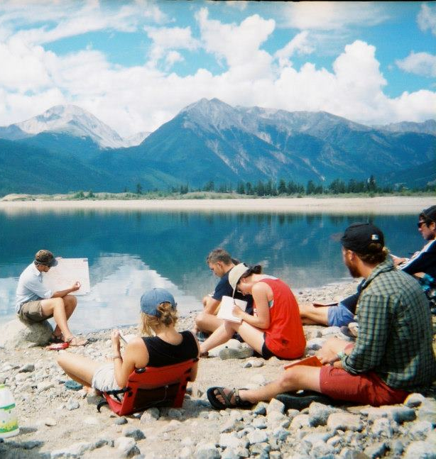
IMPLICATIONS FOR
UNDERGRADUATE EDUCATION
First, my thoughts from my undergraduate teaching experience, then I want to hear yours!
How does this translate to undergraduate education?
How can we better prepare undergraduates for this type of graduate program or job world?
Are team-based theses/capstone-experiences needed for the undergraduate experience?
IGERT Overview - Doctoral Models - Idaho Model - Improved Model - Implications

Slide 33
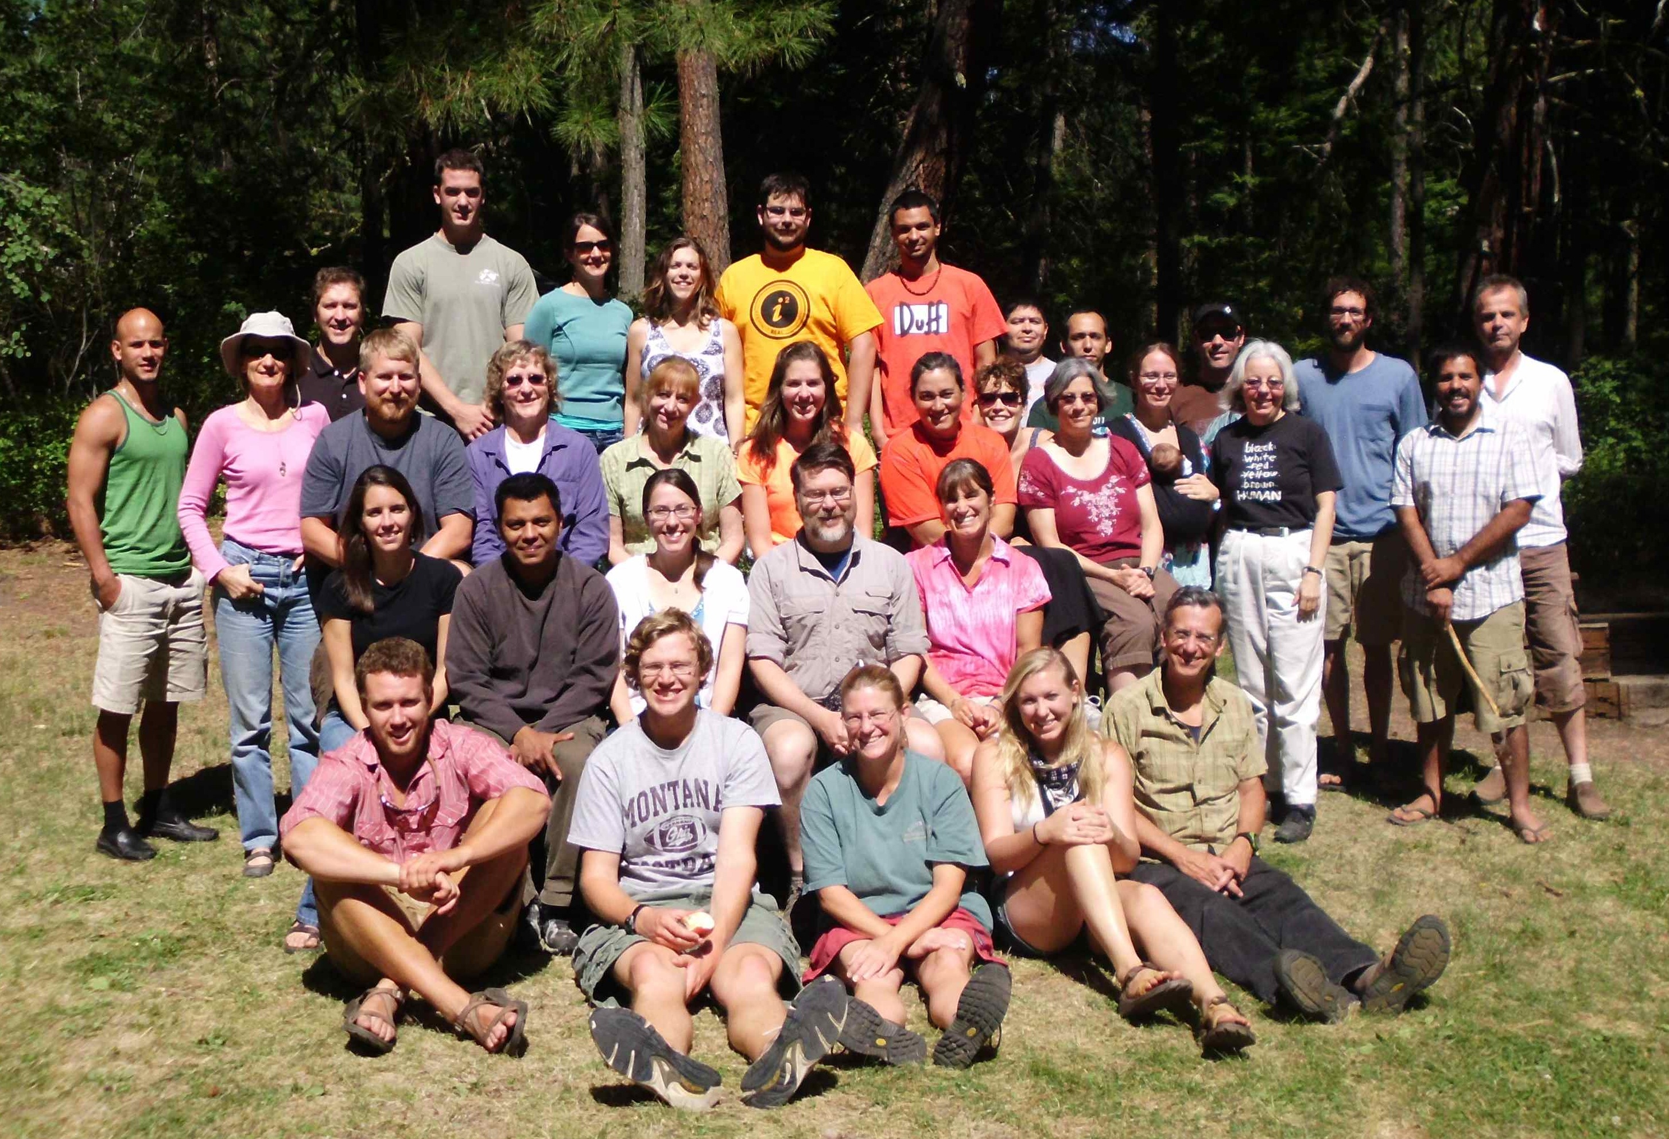
Now time for some discussion!
...oh, and THANK YOU from the Idaho IGERT!!!
Contact: zion@uidaho.edu; (920) 883-8617

Slide 35
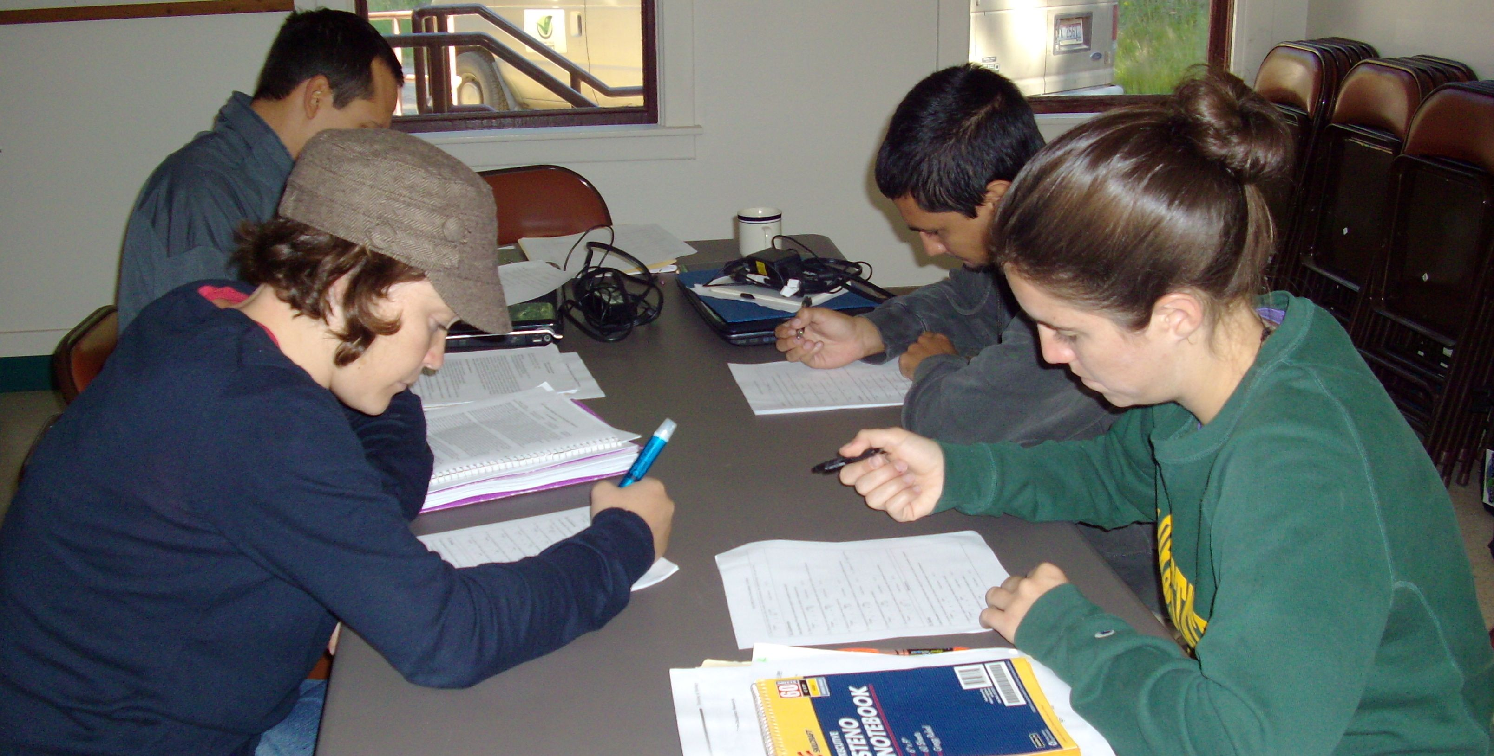
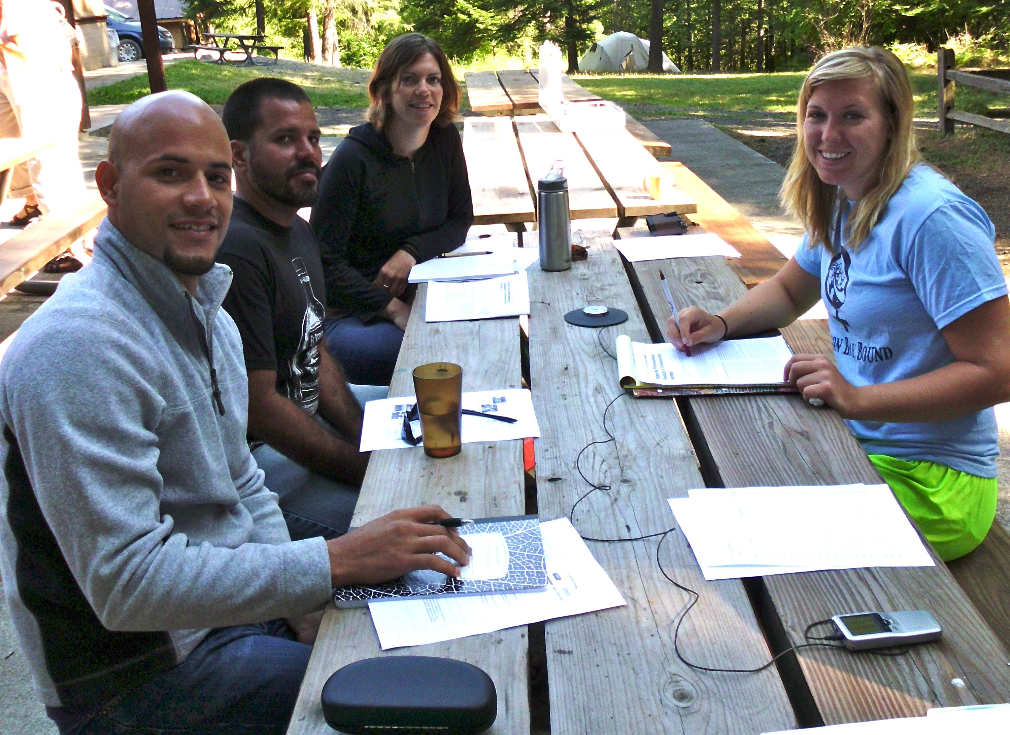
Summer Immersion & Methods Courses
During the courses students:
• Engage in a 2-day retreat-style team-building exercise.
• Take part in the collaborative science toolbox exercise.
• Work closely with faculty to explore disciplinary and interdisciplinary research questions to be addressed.
SJLS team
Hojancha team

Slide 36
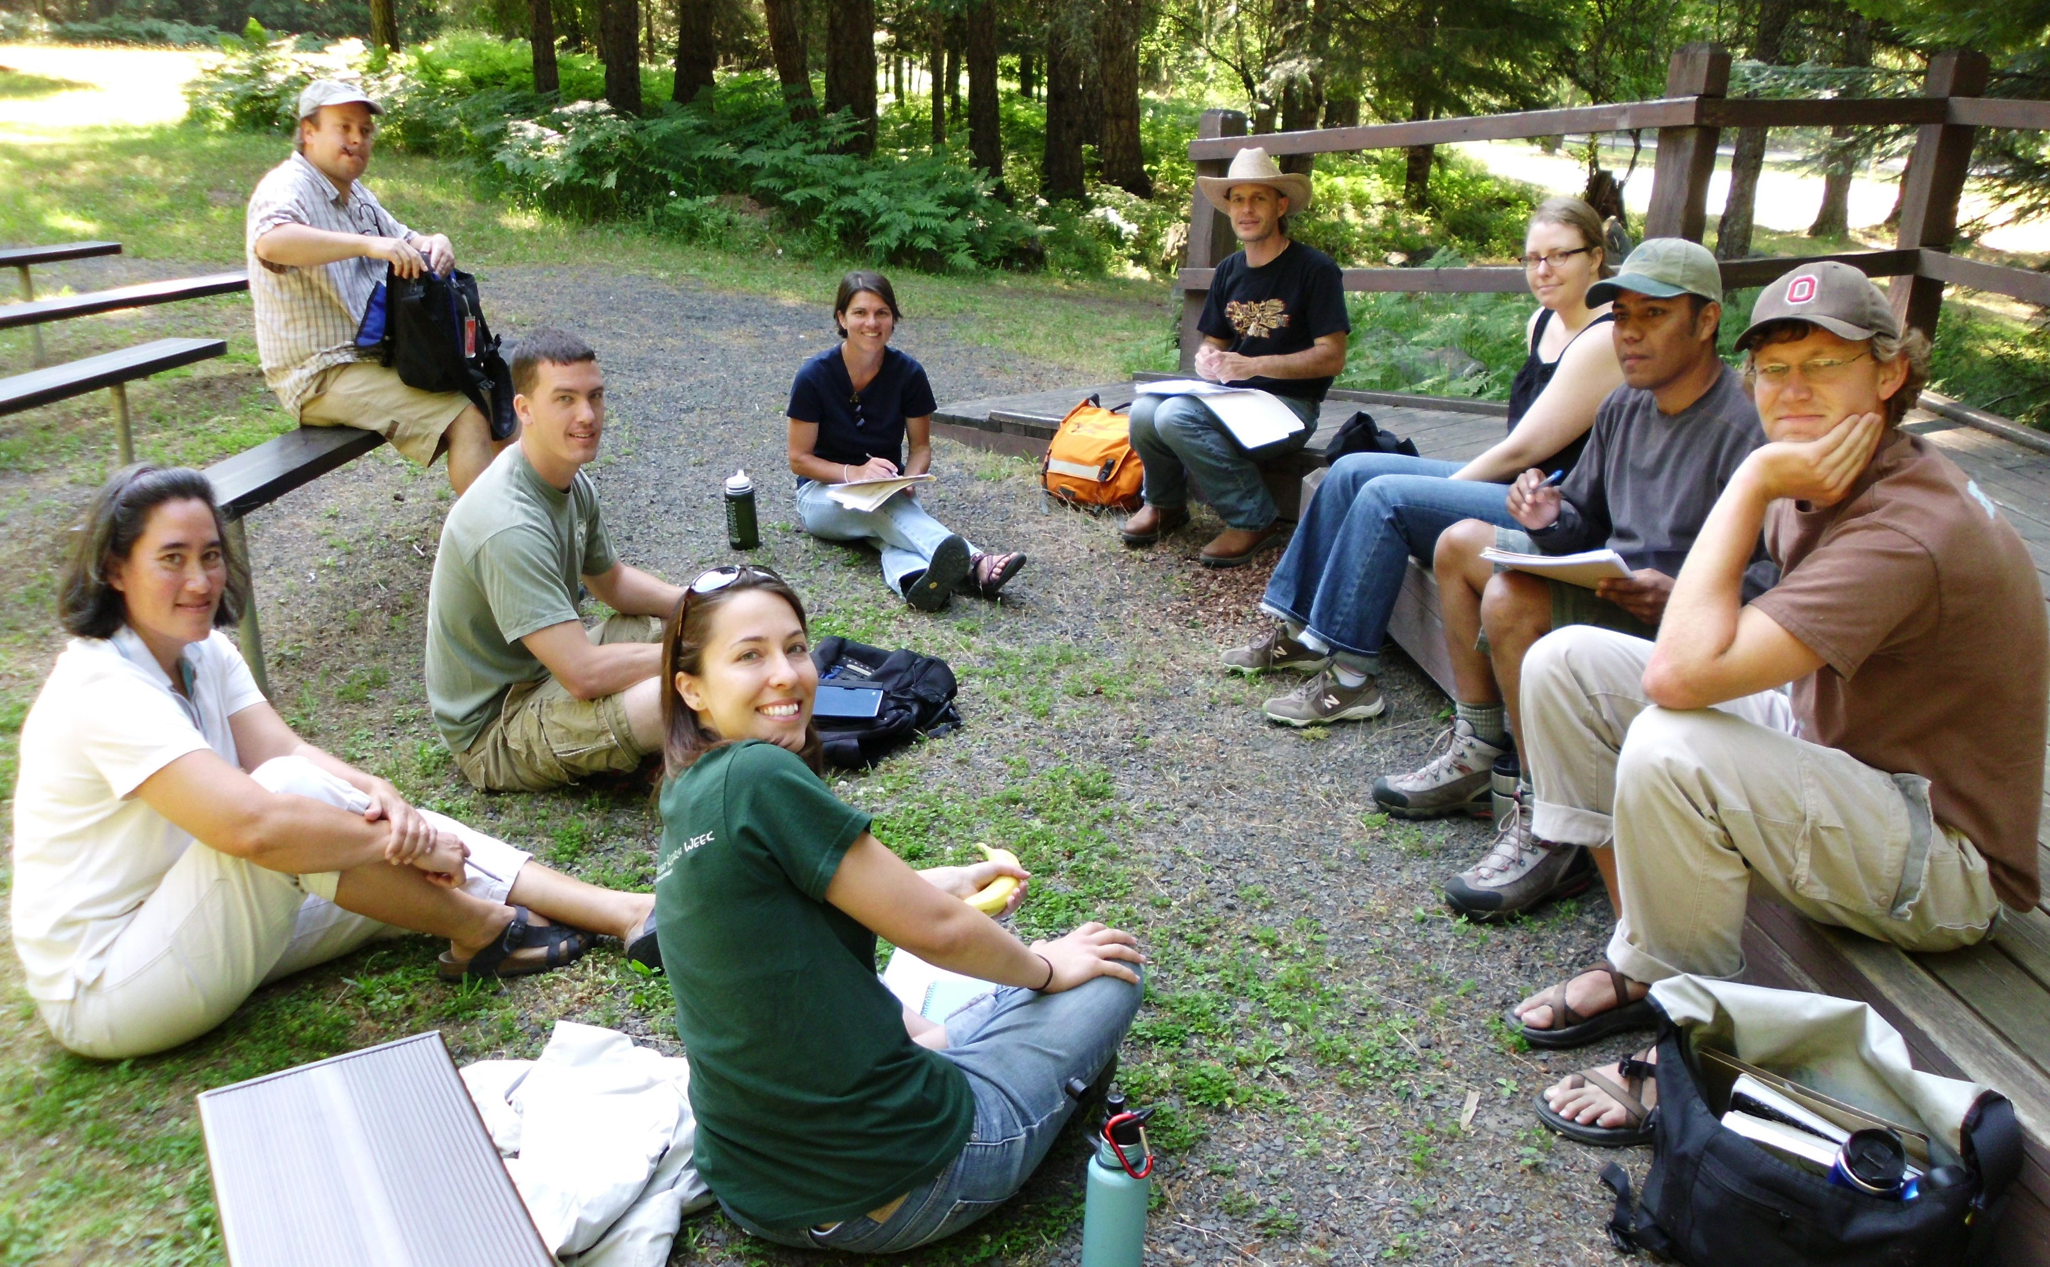
Summer Immersion & Methods Courses
• Develop conceptual models to help guide research.
• Learn research methods and philosophical and theoretical underpinnings of other disciplines.
• Develop interdisciplinary research proposals.
•
Palouse team
Sagebrush team

Slide 37
Summer Immersion & Methods Courses
• Visit potential research sites.
• Meet with stakeholders to identify researchable issues and gather ideas to help define the team’s research agenda.
• Attend presentations by stakeholders.
Meeting with stakeholders in Hojancha, Costa Rica

